Slide 1

StratusLink
Communications
Cohort 577
Notes:
Intro and Objective - Inventory

Slide 2
CONTENTS
1
2
3
Introduction
Spatial
Audience
4
5
6
Creative
Inventory
Conclusion
Notes:
Intro and Objective - Inventory

Slide 3
Introduction
1
Notes:
Intro and Objective - Inventory

Slide 4
Objective
Analyze the client’s multi-channel marketing campaign using Spatial/Location, Audience, Creative, and Inventory data to identify performance trends, benchmark KPIs, and uncover actionable insights that will improve future campaign strategy, efficiency, and overall effectiveness.
What We Aim to Deliver
Benchmark campaign performance against key KPIs (CTR, CPC, CPCV, Conversion Rates, CPM, vCPM, Viewability).
Identify high-performing segments across geography, audience groups, creative formats, and inventory sources.
Highlight optimization opportunities to improve spend efficiency and engagement.
Provide clear recommendations that support future planning and strategic decision-making.
Notes:
Intro and Objective - Inventory
Our goal for this project was to analyze using audience, creative, spatial/location, and inventory data
We wanted to understand overall performance by looking at key KPIs

Slide 5
Primary KPI’s
Cost Per Conversion (CPCV) | $50 | Track spend per valuable action.
Click Through Rate (CTR) | 10% | Reflects ad relevance and user engagement.
Cost Per Click (CPC) | $25 | Cost-efficiency per user click.
Desktop Conversion Rate | 50% | Evaluate desktop user conversion success.
Smartphone Conversion Rate | 50% | Evaluate mobile performance.
Notes:
Spatial - Ibrahim

Slide 6
Secondary KPI’s
Cost Per Mille (CPM) | $2,500 | General cost per 1,000 impressions.
Viewable CPM (vCPM) | $5,000 | Cost per 1,000 viewed impressions.
Viewability Rate | 70% | Measures ad exposure likelihood.
Notes:
Creative - Lisa

Slide 7
General Overview of the Data
Total Impressions
Total Clicks
74, 904, 335
Total Conversions
37,877,995
Ad Impressions……………. | 604,389,196
Measurable Impressions….. | 300,670,366
Viewable Impressions…….. | 148,616,508
Average Advertising Cost
$1, 008, 940
Average Acquisition Costs
$698, 821
25 Websites in Data
6 Ad Exchanges in Data
Notes:
General Overview - Audience

Slide 8
Spatial
2

Slide 9
General Overview (Spatial)
 | South | West | Midwest | Northeast
States | 16 | 13 | 12 | 9
Users | 144 | 94 | 84 | 72
Impressions | 396,433,455 | 301,887,324 | 274,040,667 | 244,418,019
Clicks | 49,833,580 | 37,850,859 | 33,844,177 | 31,416,878
Conversions | 25,172,012 | 19,588,547 | 17,538,161 | 15,709,869

Slide 10
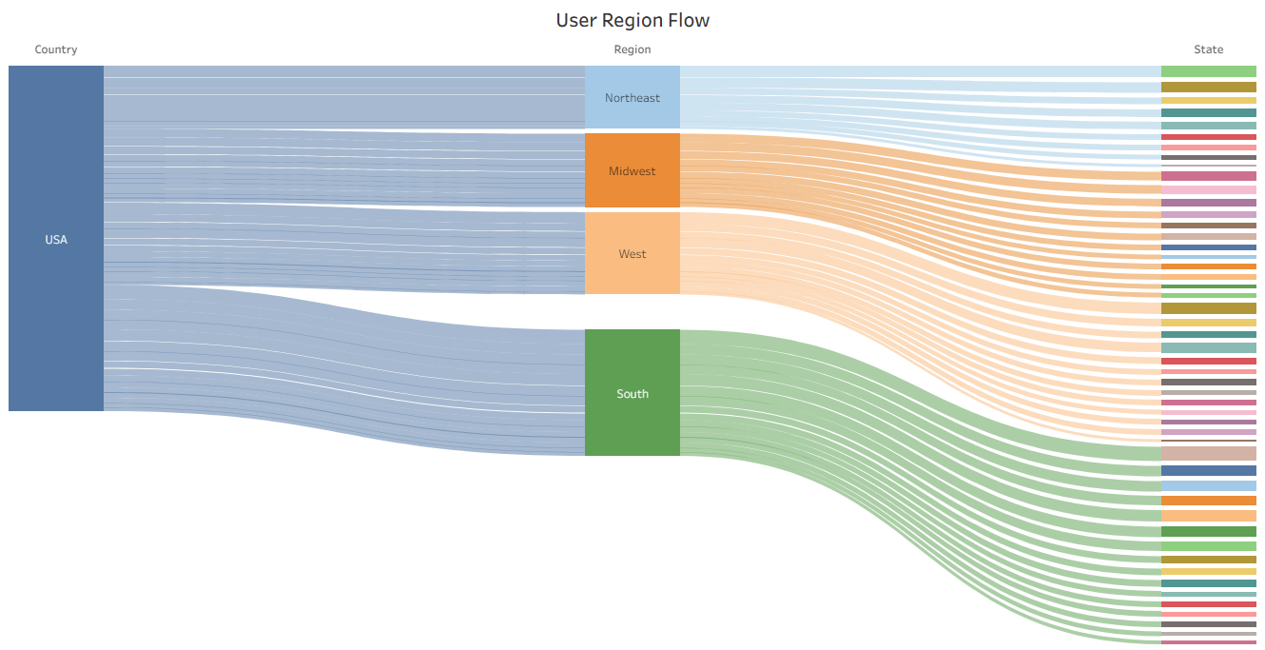
General Overview (Spatial)

Slide 11
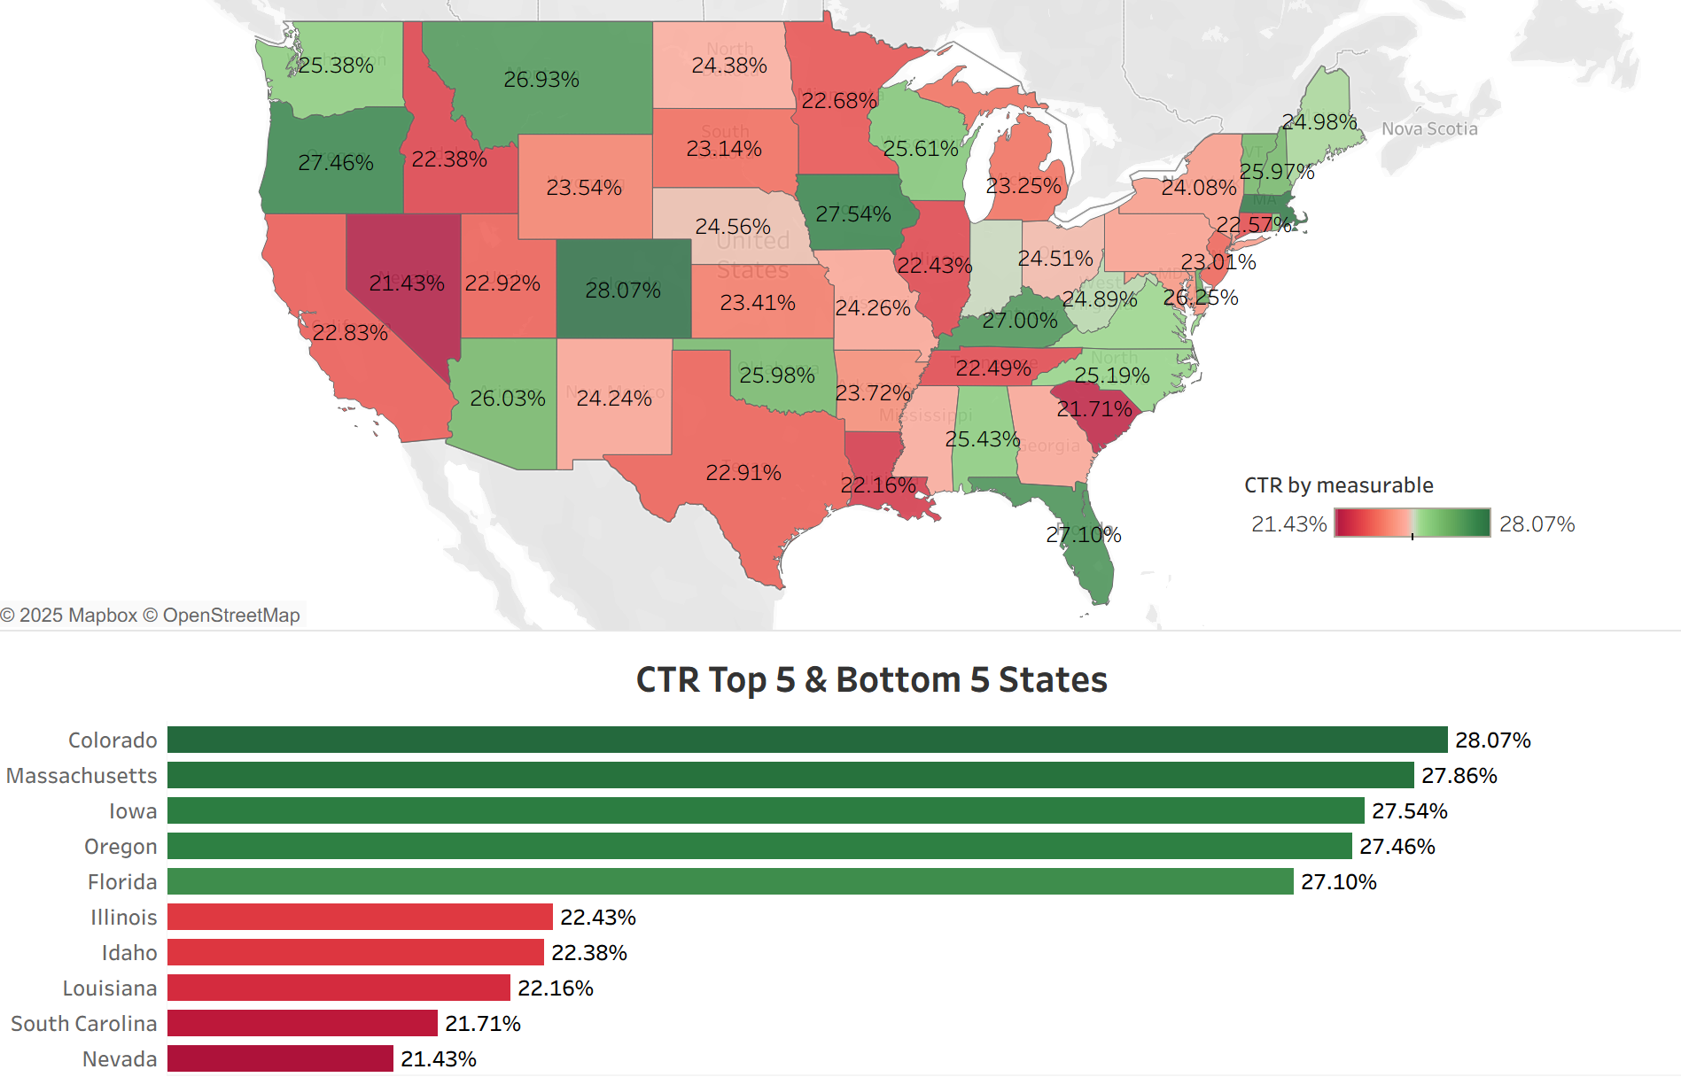
Click Through Rate by State
Highest CTR States: Approx 27-28%
Lowest CTR States: Approx 21-22%
Strong engagement in Northwest, mountain area, and Florida
Weak engagement in Nevada, Idaho, and parts of the South.
Big picture: CTR does not change a lot from state to state- most are in similar range with about 6-7 point difference

Slide 12
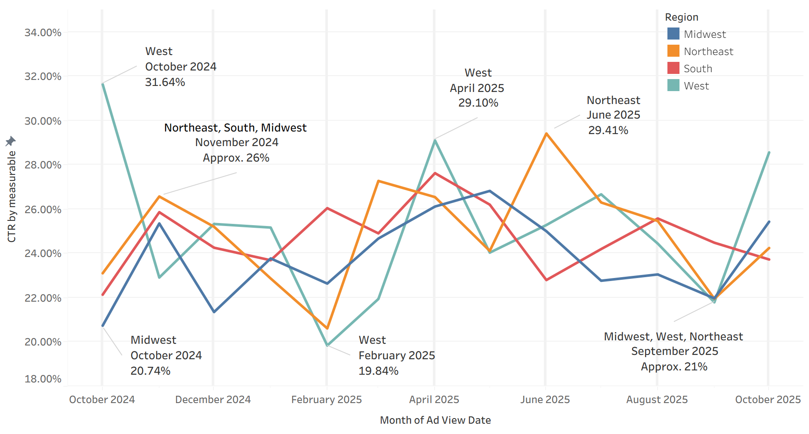
Click Through Rate by Region Chart
Major peaks: West October 2024, April 2025 and Northeast June 2025
Lowest point: All regions dip around September 2025
The West fluctuates the most (approx. 12 point difference)
Midwest starts low but becomes steady mid-year
Big picture: CTR changes depending on time of year, not just region

Slide 13
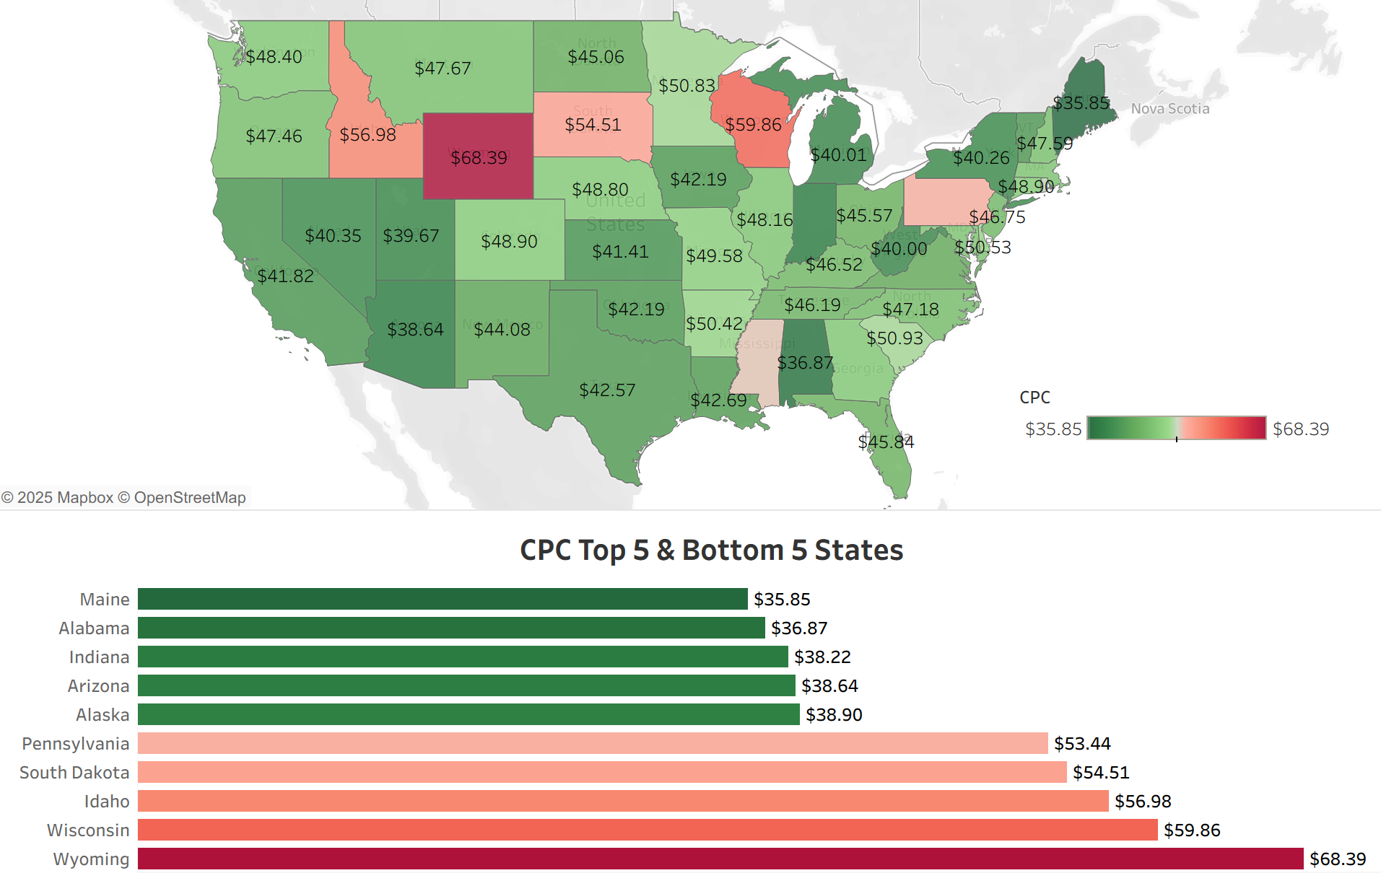
Cost Per Click by State
Lowest CPC States (most cost effective): Approx. $36-$39
Highest CPC States: Approx $53-$68
High CPC appears mostly in northern inland states
Low CPC is common in Southeast and Southwest
Big picture: Budget efficiency varies a lot- meaning some states are much cheaper to advertise in

Slide 14
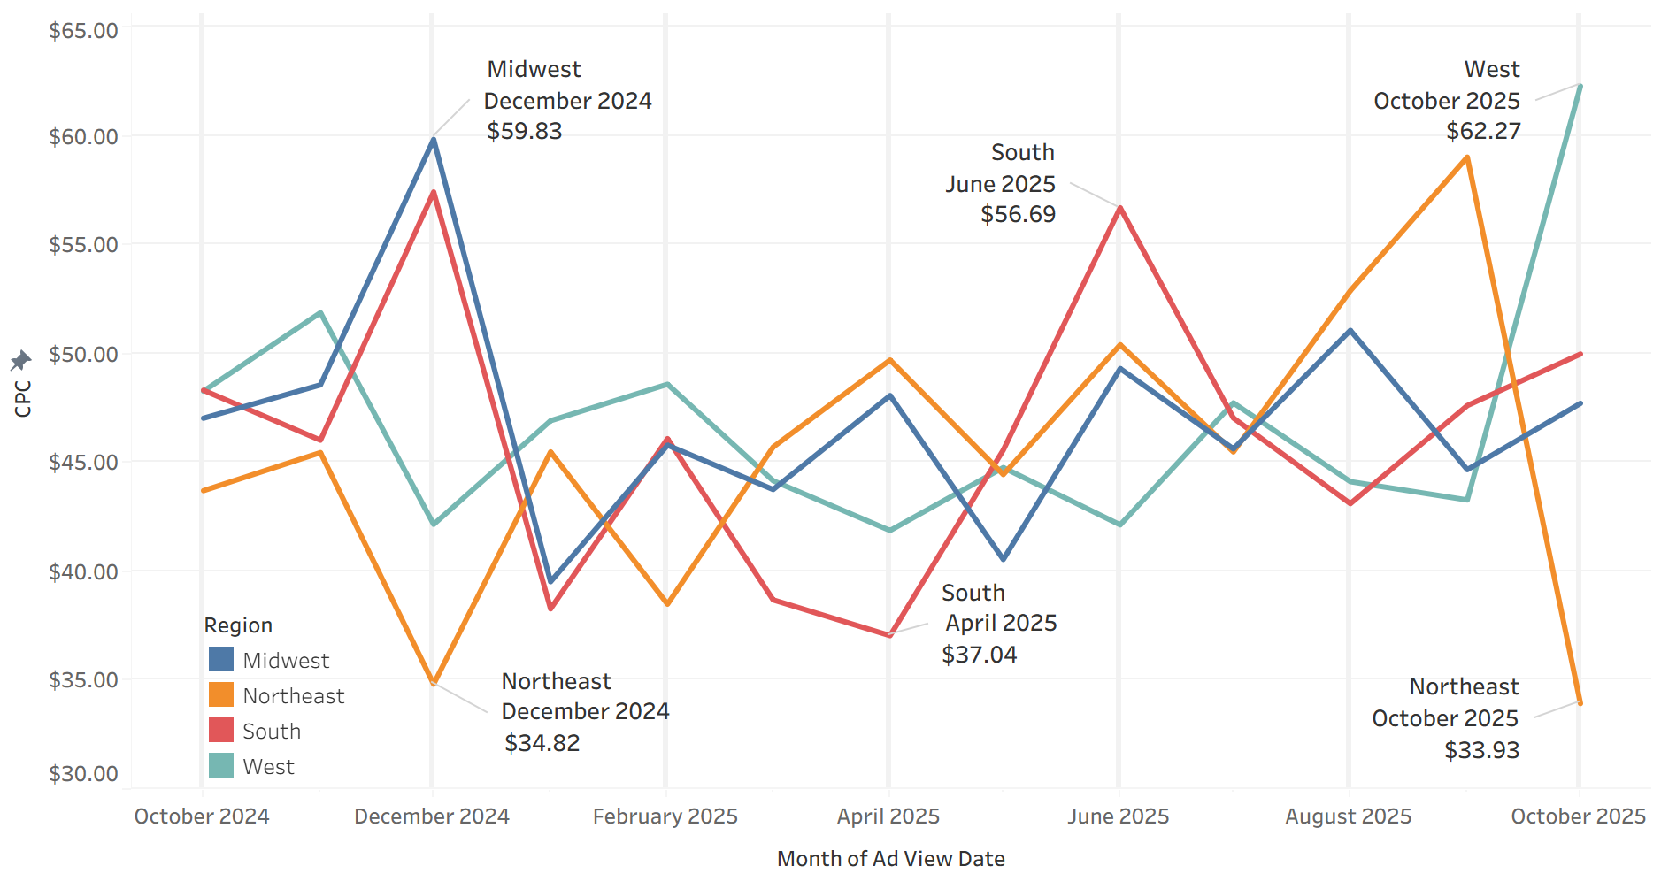
Cost Per Click by Region Chart
Lowest CPC: Northeast December 2024, October 2025 and South April 2025
Highest CPC: Midwest December 2024, South June 2025, and West October 2025
South and West fluctuate the most, Northeast remains consistently low-cost
Big picture: Timing regional spending is essential to avoid CPC spikes

Slide 15
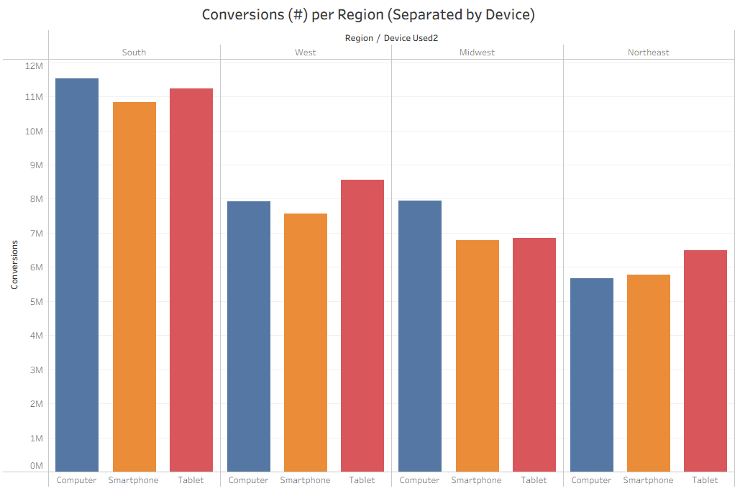
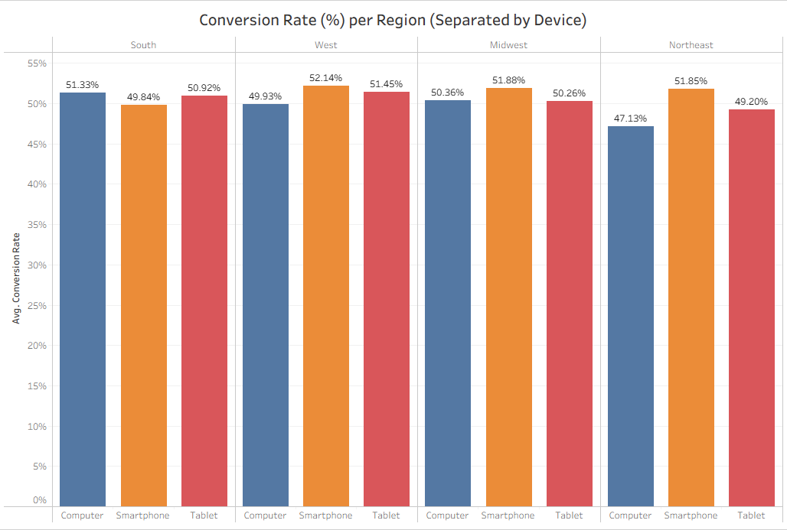
Conversions vs Conversion Rate by Region
From just looking at Conversions in each region it might seem like ads are more effective in the South, but in reality, after looking at Conversion Rate, it becomes apparent that ads have similar levels of effectiveness in each region.

Slide 16
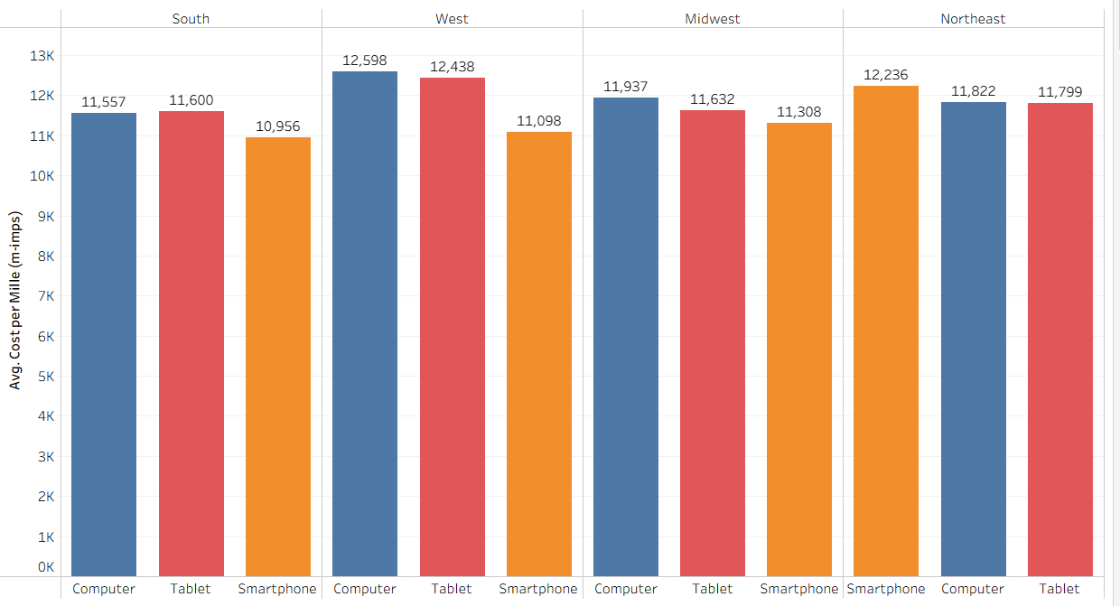
Cost Per Mille By Region for each Device

Slide 17
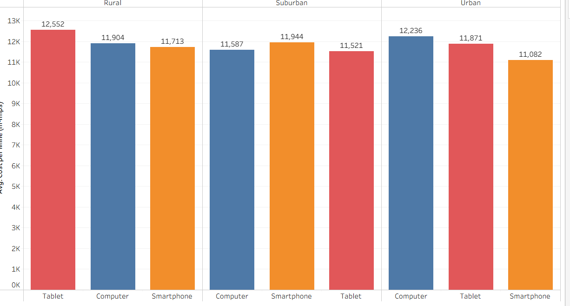
Cost Per Mille By Urbanicity for each Device

Slide 18
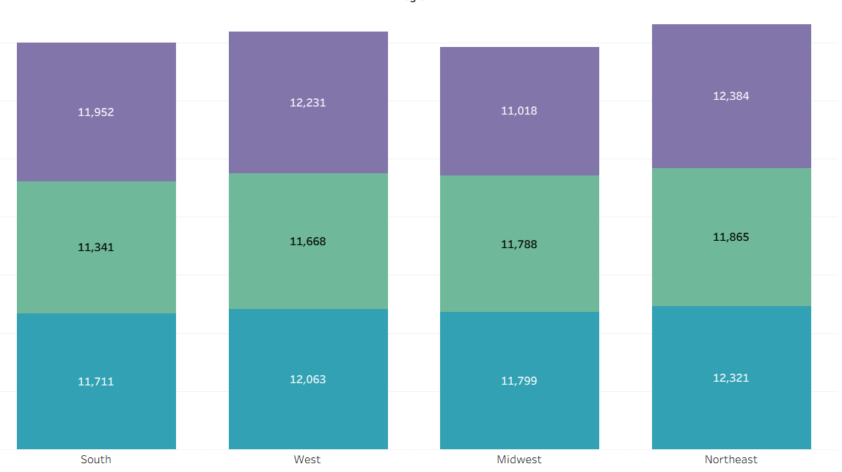
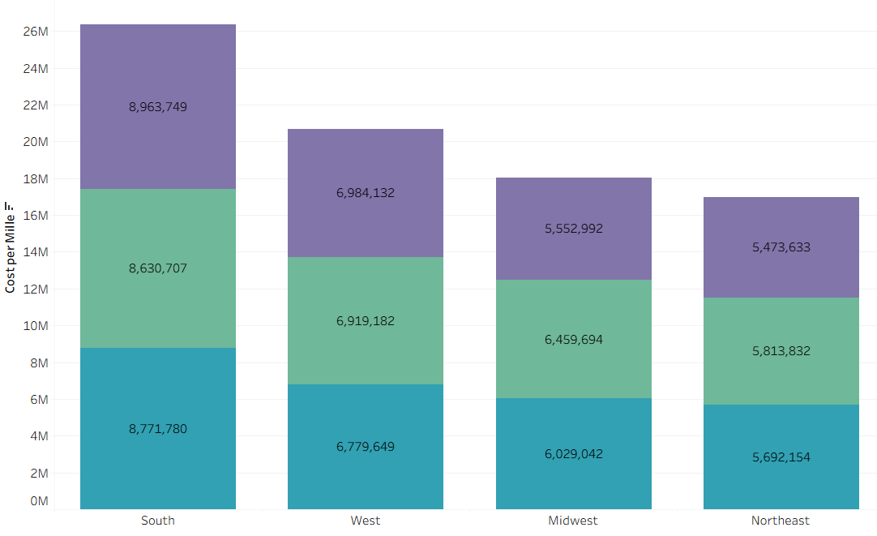
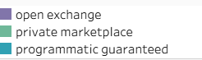
Cost Per Mille By Region and Deal Type
Notes:
Edwin

Slide 19
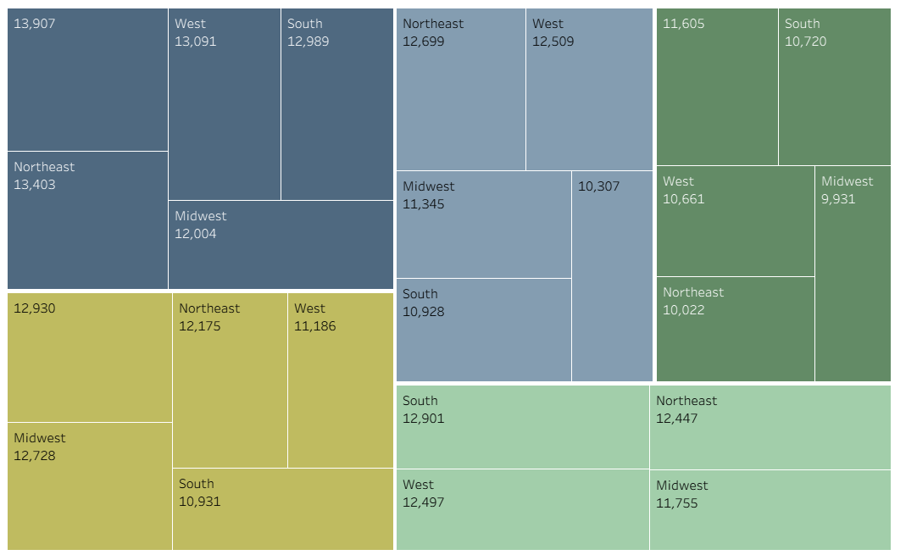
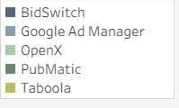
Average CPM by Ad Exchange and Region
Notes:
Edwin

Slide 20
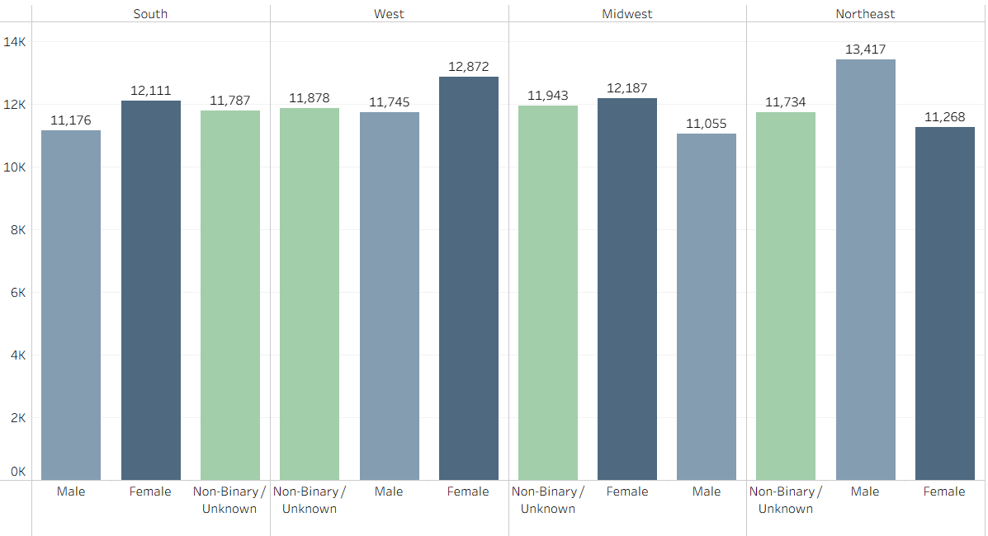
Cost Per Mille By Region and Gender
Notes:
CPM do Cost per Mille and Region and Gender

Slide 21
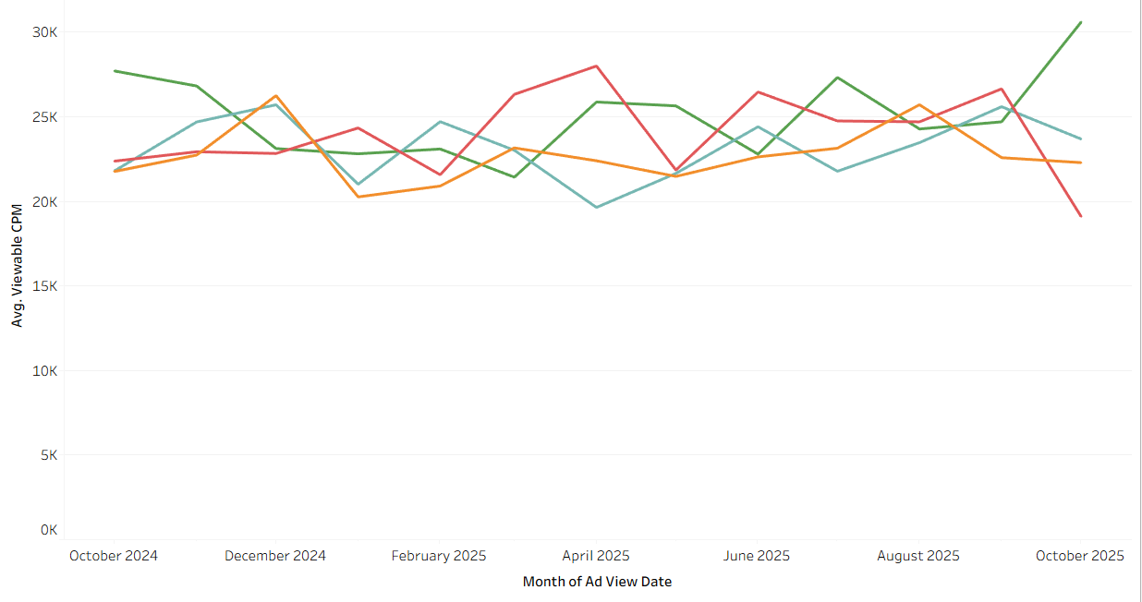
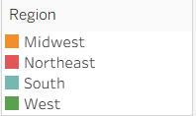
Average Viewable CPM for Each Region by Month
Notes:
Edwin

Slide 22
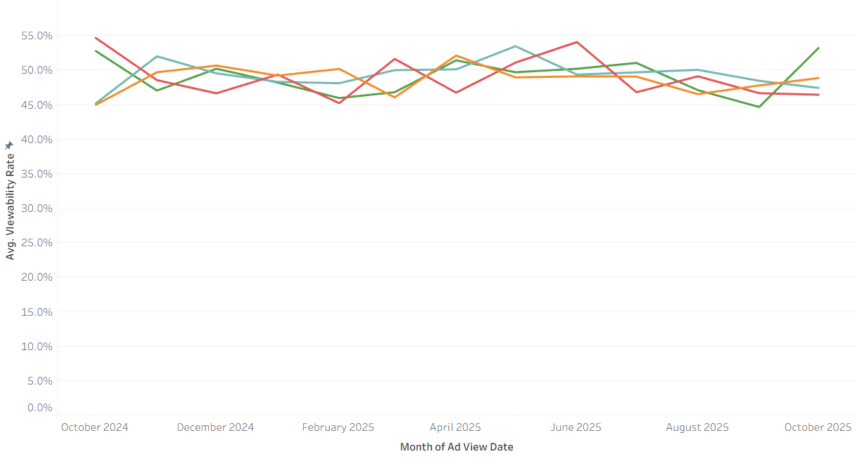
Average Viewability Rate for Each Region by Month
Notes:
Edwin

Slide 23
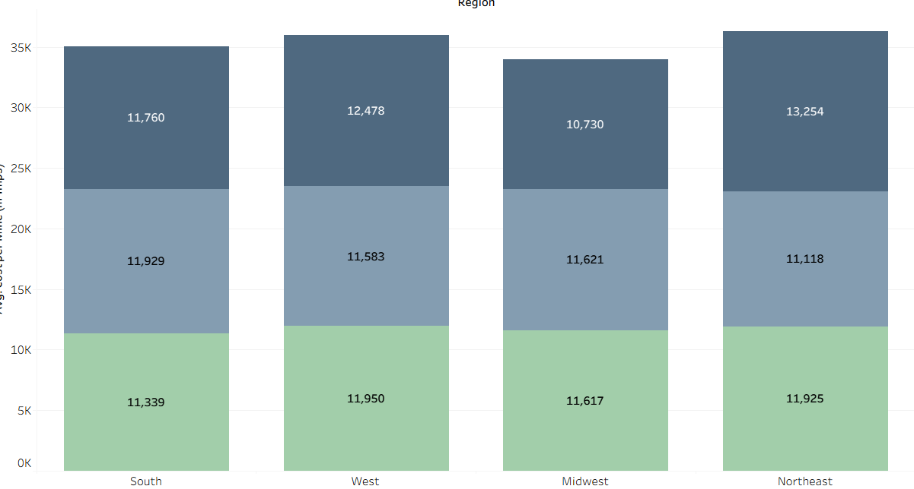
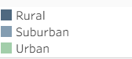
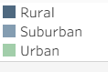
Cost Per Mille (CPM) by Region and Urbanicity
Notes:
Edwin

Slide 24
Audience
3

Slide 25
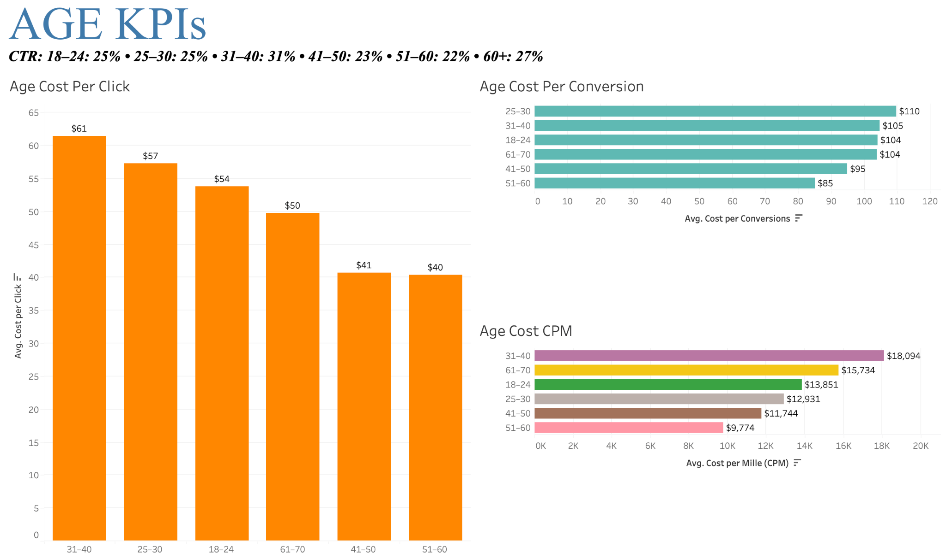

Slide 26
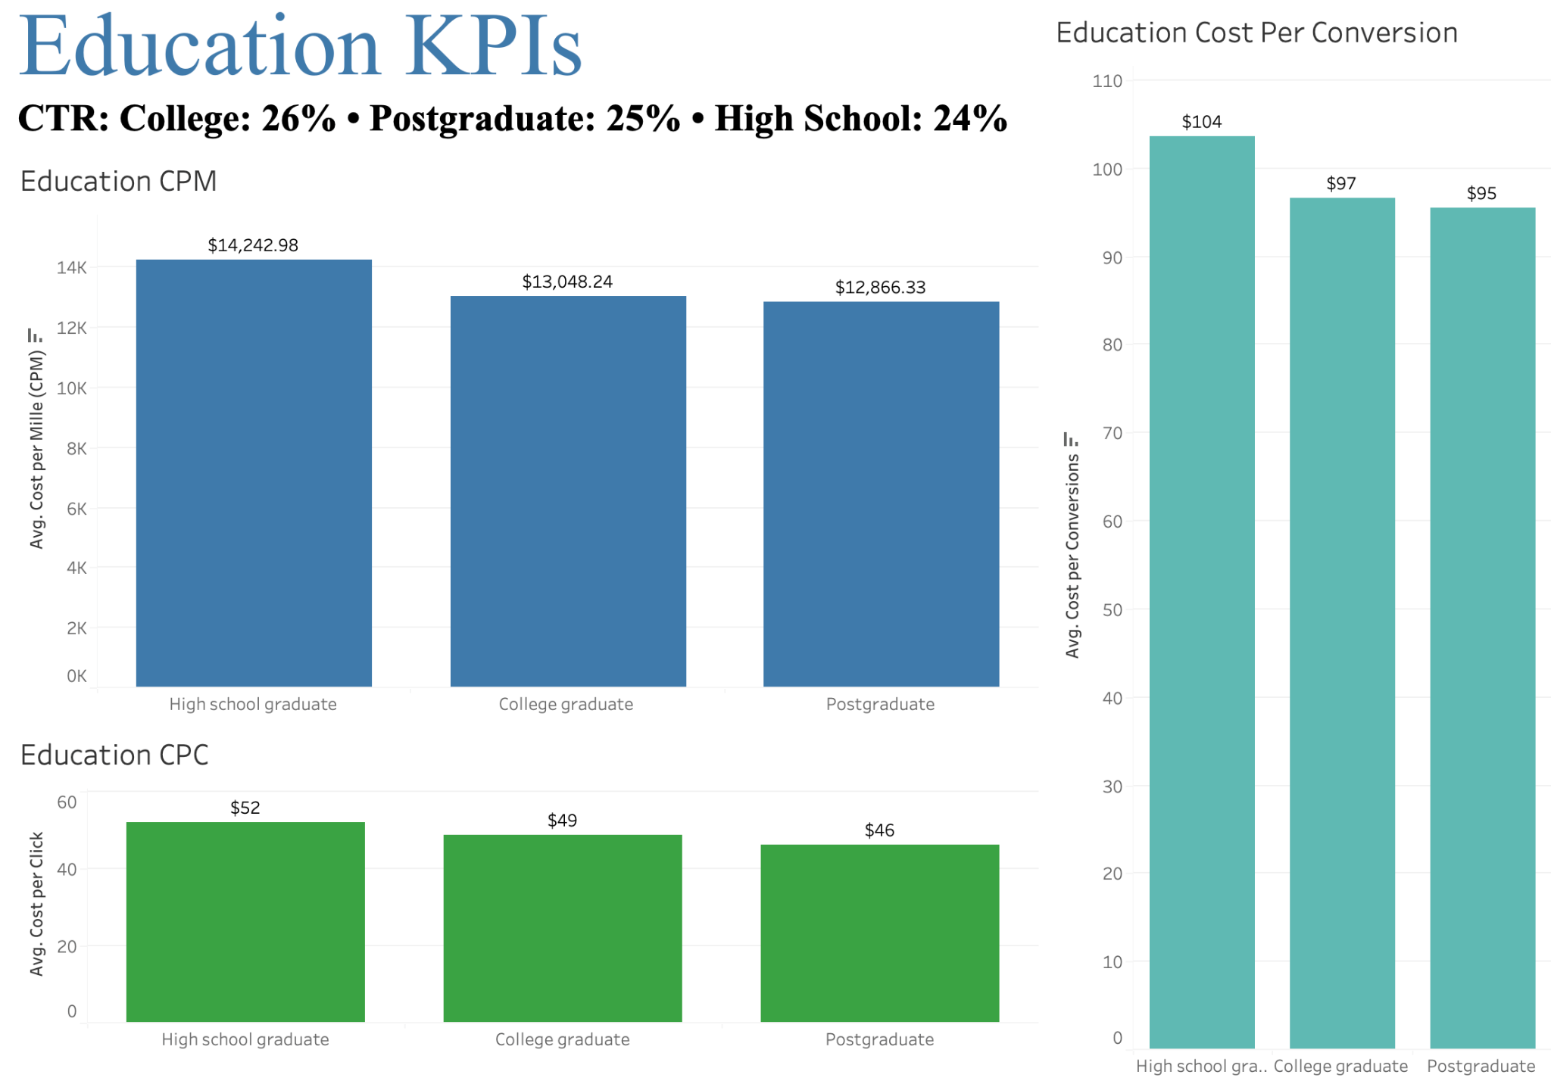

Slide 27
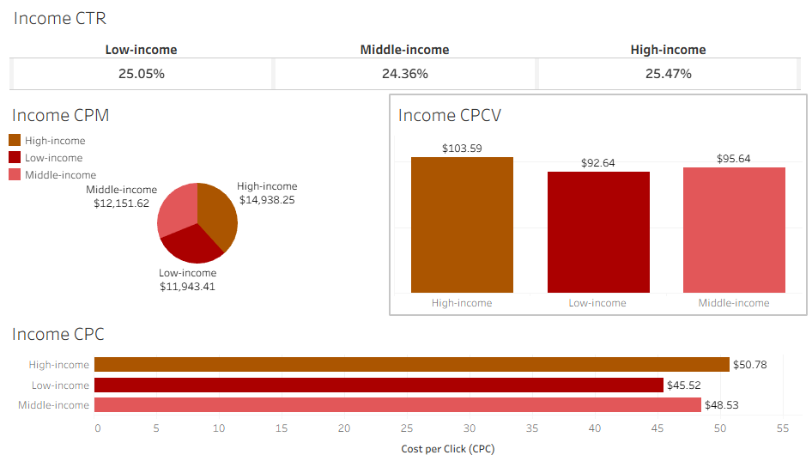
Income KPI’S

Slide 28
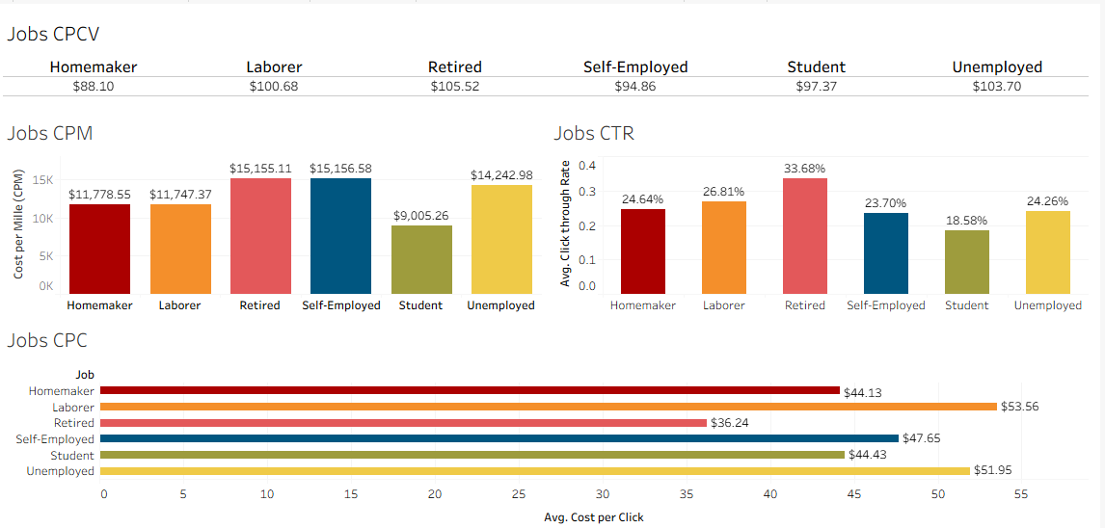
Jobs KPI’S

Slide 29
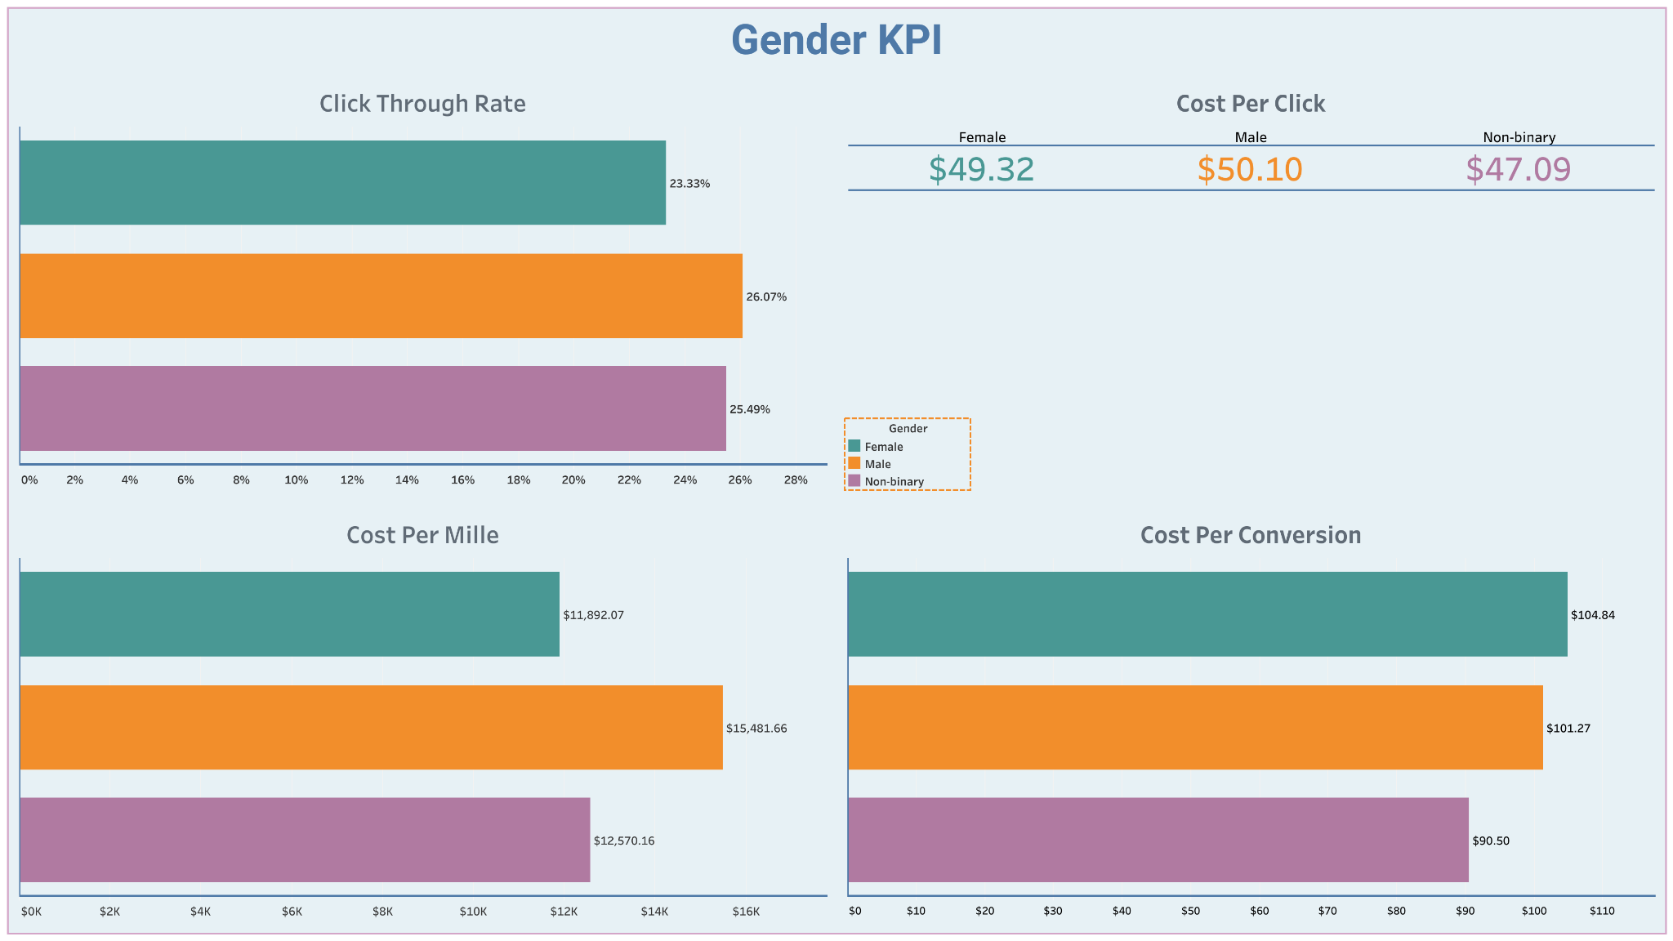
Males have the highest engagement (CTR), but are not cost efficient
Non-binary are the best target with high engagement and low cost

Slide 30
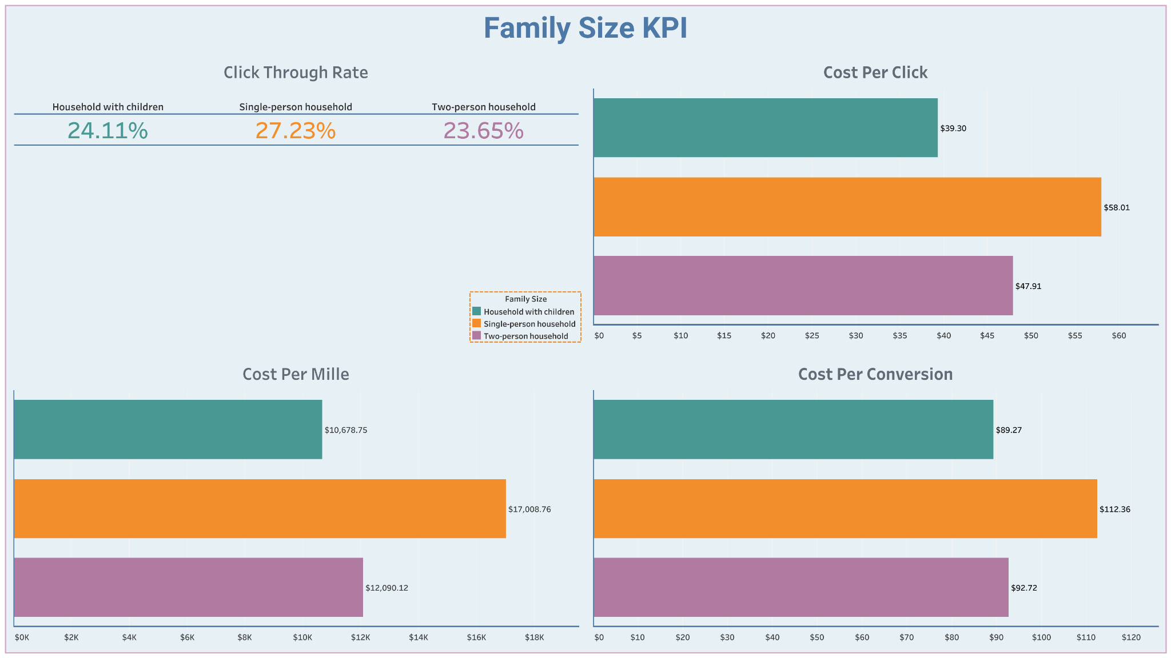
Single-person households are the least cost efficient, but also most likely to click on ads (CTR)
Households with children are the most cost efficient and best target for campaigns

Slide 31
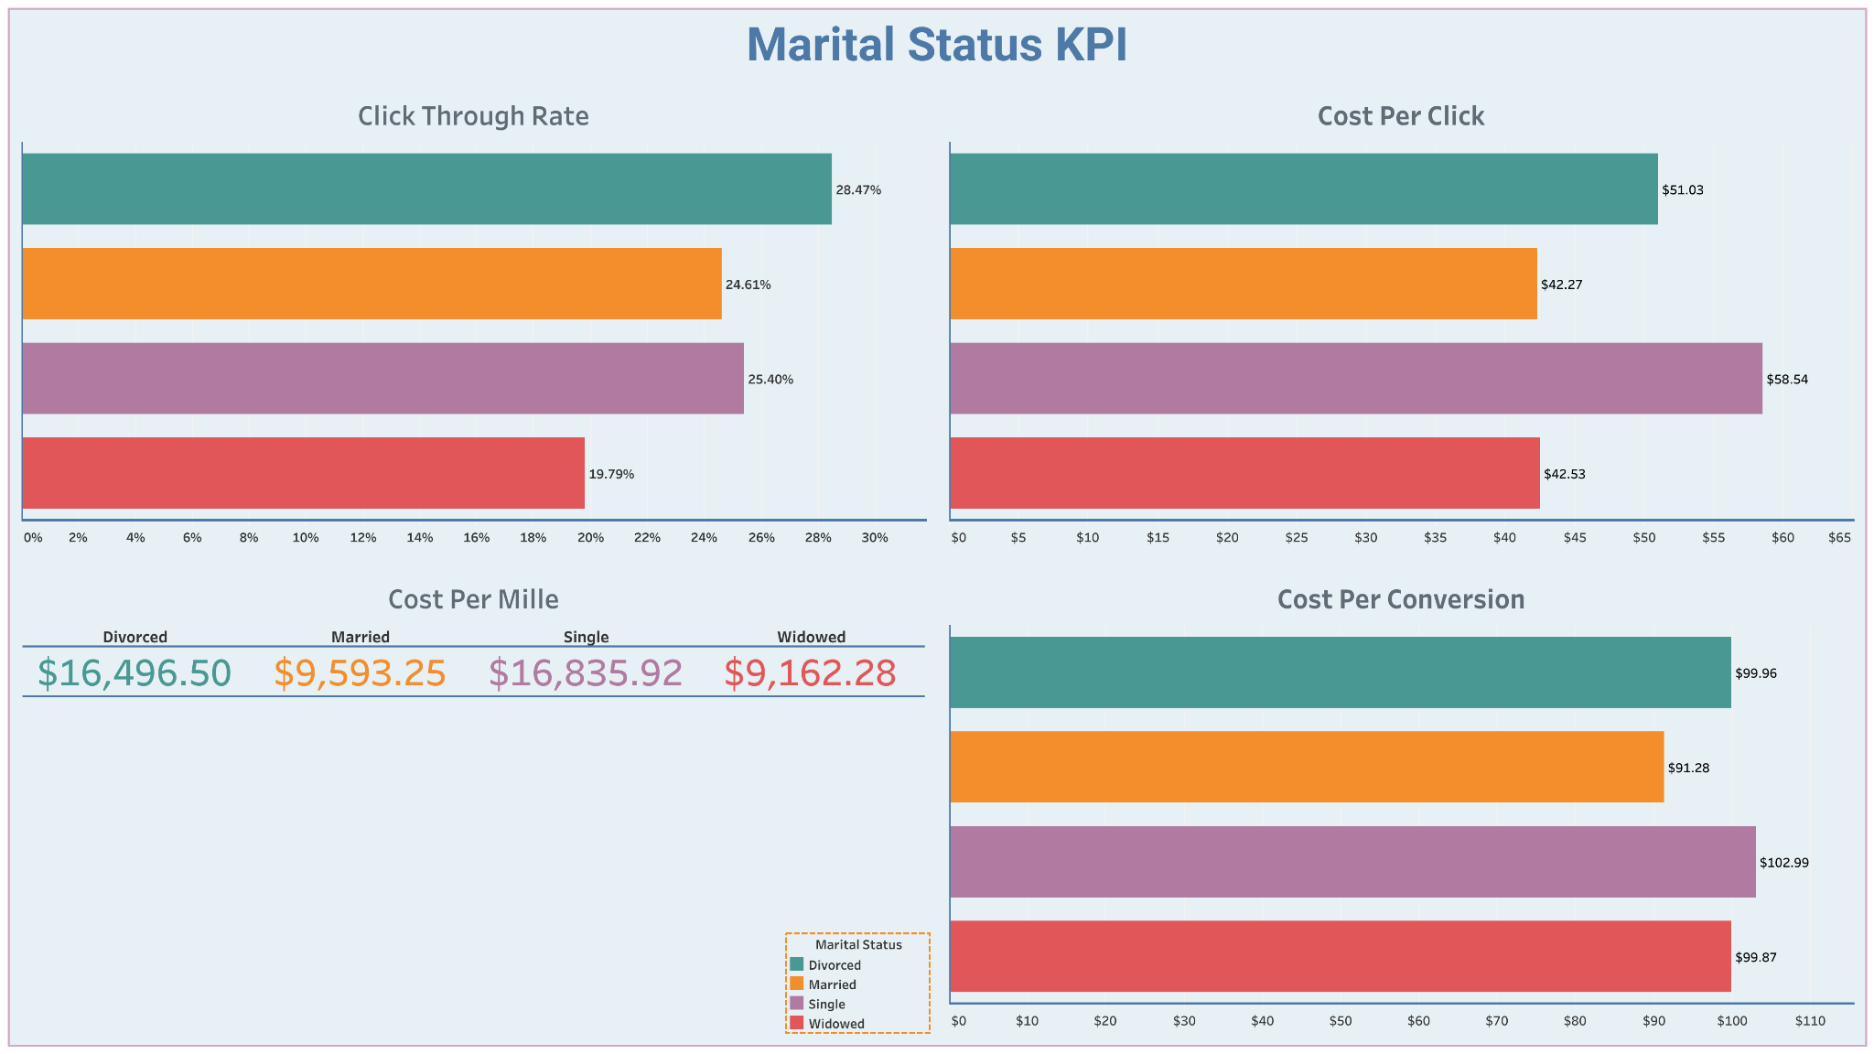
Married have the lowest CPC and CPCV, making them the best target for campaigns
Divorced and Single have the highest CTR, but is costly
Widows are the most cost efficient, but has low engagement (CTR)

Slide 32
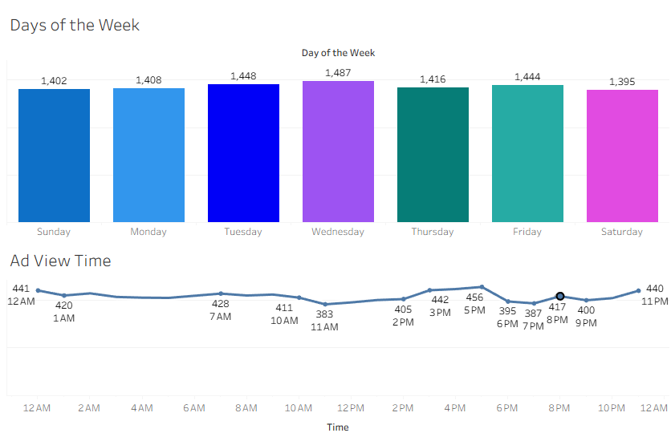
Behavioral Segment

Slide 33
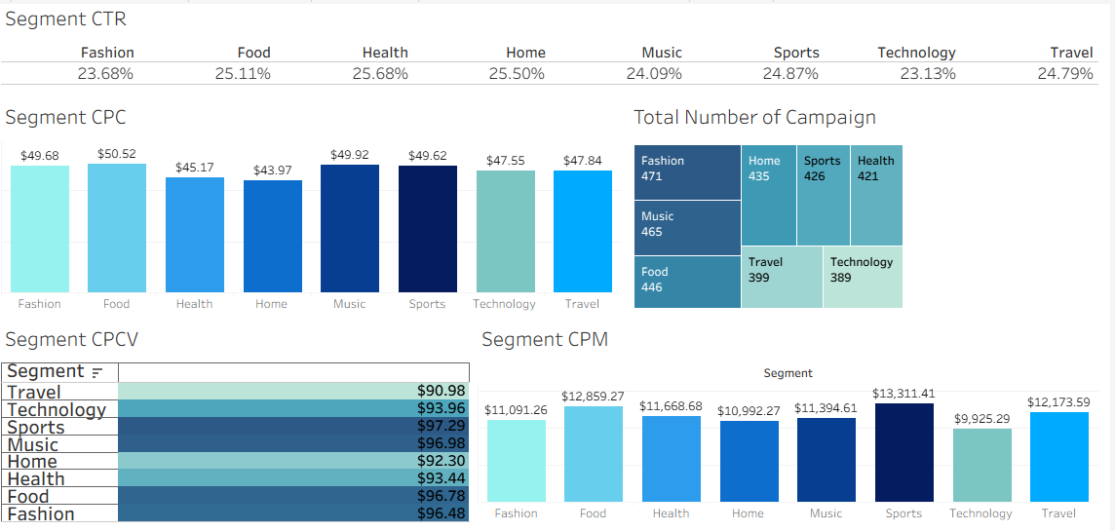
Campaign KPI’S

Slide 34
KPI Personas
1. Worst- High-Expense John is a detailed researcher. He’s just expensive, slow, and extremely picky. He has money, but he won’t spend it until he’s 100% confident in his choice.
Gender: Male (CTR 26.07%)
Age: 31–40 (Worst CPC $61)
Education: High School Graduate (CPC $52)
Occupation: Retired (Highest CPCV $105.52)
Household: Single-person household (CPC $58.01)
Marital Status: Single (CPC $58.54)
Income: Middle income
Geography
Region: West Coast
States: California, Oregon, Washington
Interests:
Sports (CPCV: $97.29)
Technology (CPCV: $93.96)
Music ( CPCV: $96.98)
2. Average- Jane a steady, practical, and predictable user who stays consistent in her engagement and balances her interest
Gender: Female (CPC $50.10)
Age: 24 (CPC $54)
Education: College Graduate(CPC $49)
Occupation: Self-employed (CPCV $94.86)
Household: Two-person household (CPC $47.91)
Marital Status: Divorced (CPC $51.03)
Income: Middle Income
Geography
Region: South
States: Alabama, Arkansas and North Carolina
Interest
Technology (CPC $47.55)
Home & Sports (Average Campaign Count)
3. Best Cost Efficient Alex
Retired parent with their family’s best interest in mind
Gender: Non-binary (CPCV $90.50)
Age: 51-60 (most cost-efficient)
Education: Postgraduate (CPC $46)
Occupation: Retired (CTR 33.68%)
Household: Household with Children (CPC $39.30)
Marital Status: Married (CPC $42.27)
Income: Low Income (CPCV $92.62)
Geography
Region: Northeast
States: Maine, Vermont, Massachusetts
Urbanicity: Rural
Interest
Fashion, Music, Food (Top Topics)
Health (CTR 25.6%)
Home (CTR 25.50%)

Slide 35
Creative
4

Slide 36
Creative Messaging
Notes:
Lisa

Slide 37
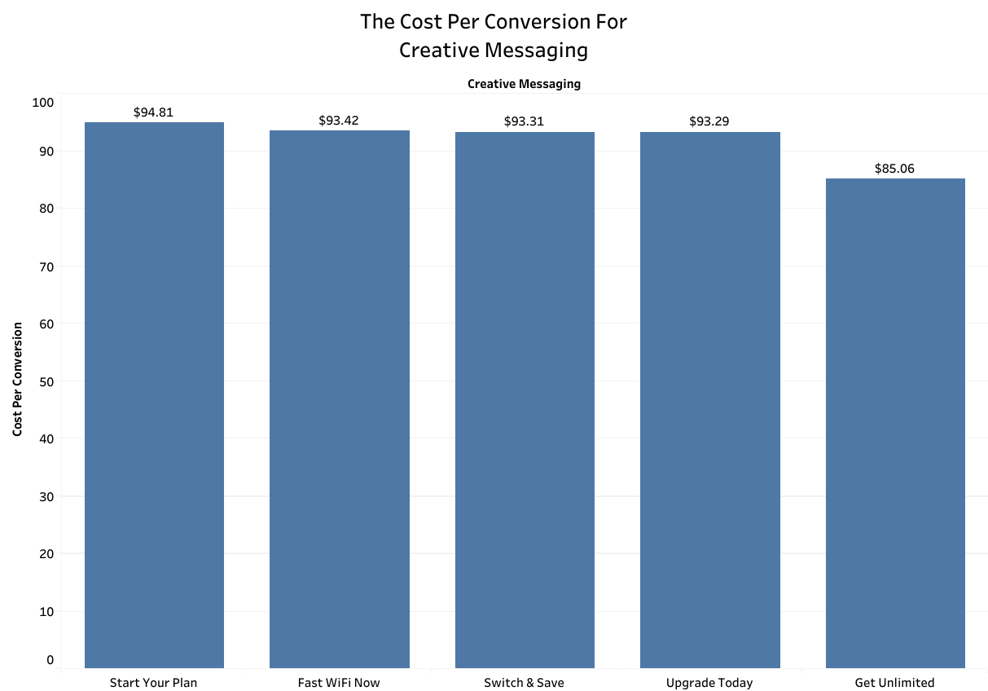
The Cost Per Conversion For Creative Messaging
Benchmark goal: $50
Most Cost Efficient: “Get Unlimited”
Least Cost Efficient: “Start Your Plan”
Average: $91.98
Notes:
Lisa

Slide 38
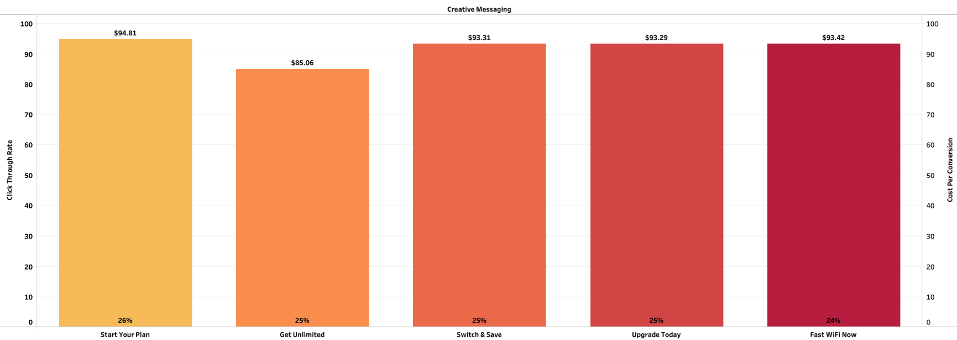
CTR and CPCV Comparison by Creative Messaging
CPCV Benchmark goal: $50
CTR Benchmark goal: 10%
All creative messaging exceeded CTR goals by 14%-16% more, which shows strong engagement.
Most cost efficient and least cost efficient remain the same.
“Get Unlimited” has a strong CTR and maintains the lowest CPCV, which makes it the strongest performing creative messaging here.
The other messaging have a strong CTR but are not as cost efficient.
Notes:
Lisa

Slide 39
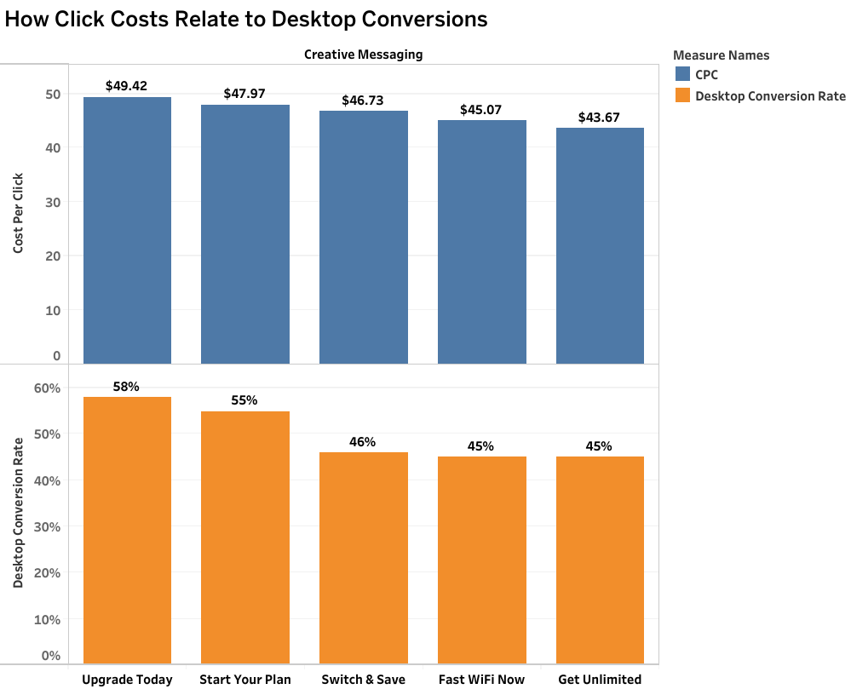

How Clicks Costs Relate to Desktop Conversions
CPC Benchmark goal: $25
Desktop Conversion Rate: 50%
“Upgrade Today” & “Start Your Plan” exceeded goals because of the clear call to action.
Notes:
Lisa

Slide 40

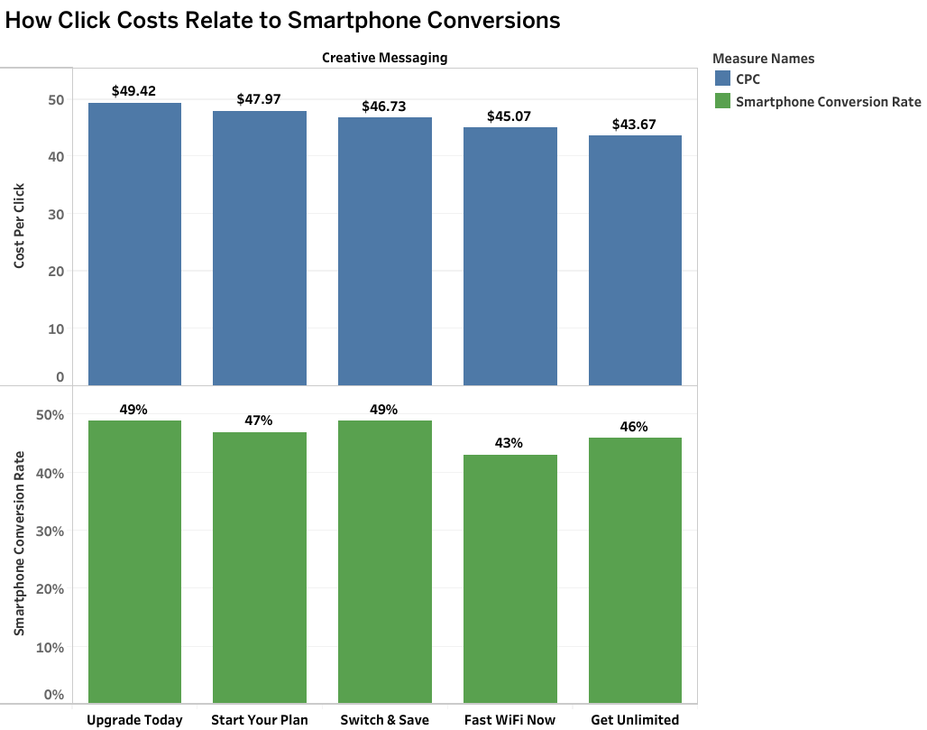
How Click Costs Relate to Smartphone Conversions
CPC Benchmark goal: $25
Smartphone Conversion Rate: 50%
All messaging fell below the benchmark goal, but “Upgrade Today” & “Start Your Plan” were extremely close to meeting the 50% goal, which again showcases that a clear CTA is important.
Notes:
Lisa

Slide 41
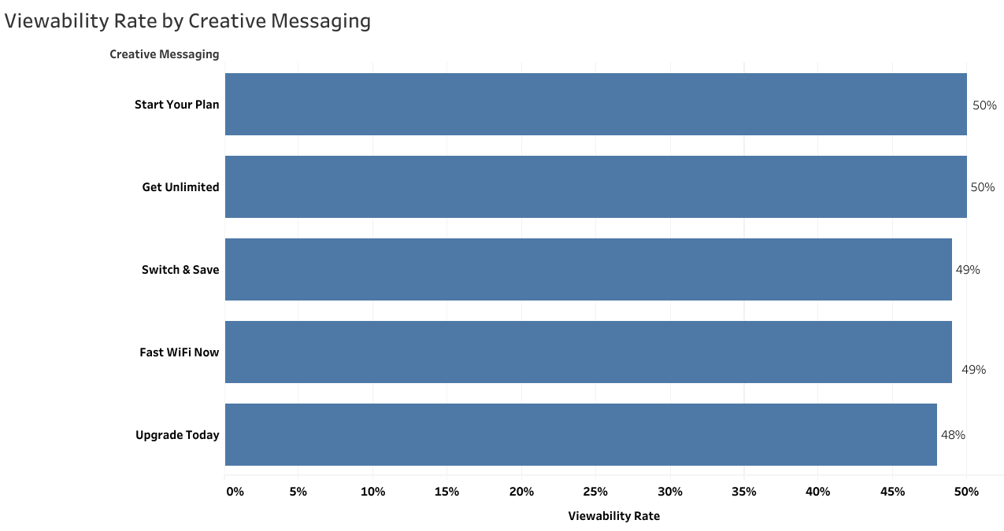
Viewability Rate by Creative Messaging
Benchmark goal: 70%
“Start Your Plan” & “Get Unlimited” are ranked higher in viewability rates compared to others.
Considerations to Improve viewability rate: Ad Format & Placement, Page Load Time, Readability, Animations
Notes:
Lisa

Slide 42
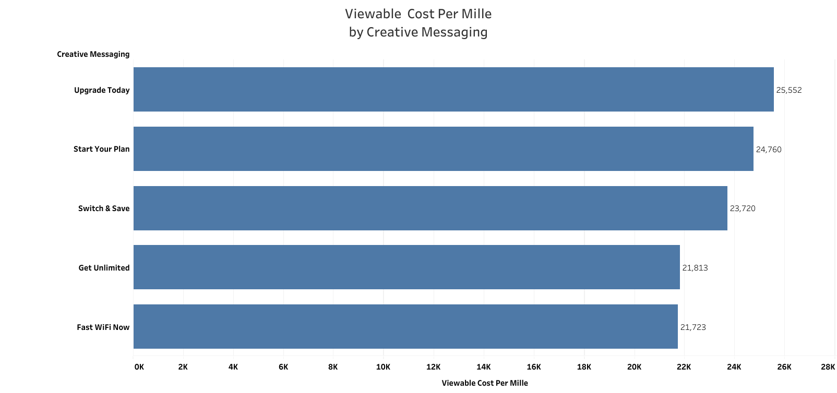
Viewable Cost Per Mille by Creative Messaging
Benchmark goal: $5,000
“Fast Wifi Now” & “Get Unlimited” deliver the most efficient & visibility-focused viewable impressions.
Since viewable impressions are such high-cost across all messaging, it might be more effective to focus on other KPIs (CPCV, CTR, conversions) rather than overspending on this KPI.
Notes:
Lisa

Slide 43
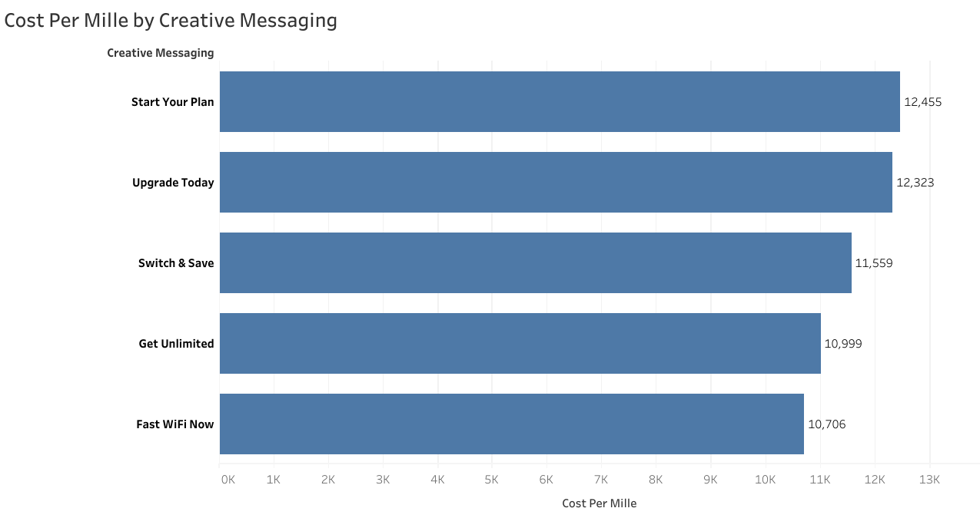
Cost Per Mille by Creative Messaging
Benchmark goal: $2,500
“Fast Wifi Now” & “Get Unlimited” are more efficient & visibility-focused here again.
Creative messaging like “Start Your Plan” & “Upgrade Today” are the least efficient & visibility-focused here. However, if these creative messaging are exceeding the primary KPI benchmarks (CTR & Desktop Conversions), then the high CPM is justified.
Notes:
Lisa

Slide 44
Creative Sizes
Notes:
Billy

Slide 45
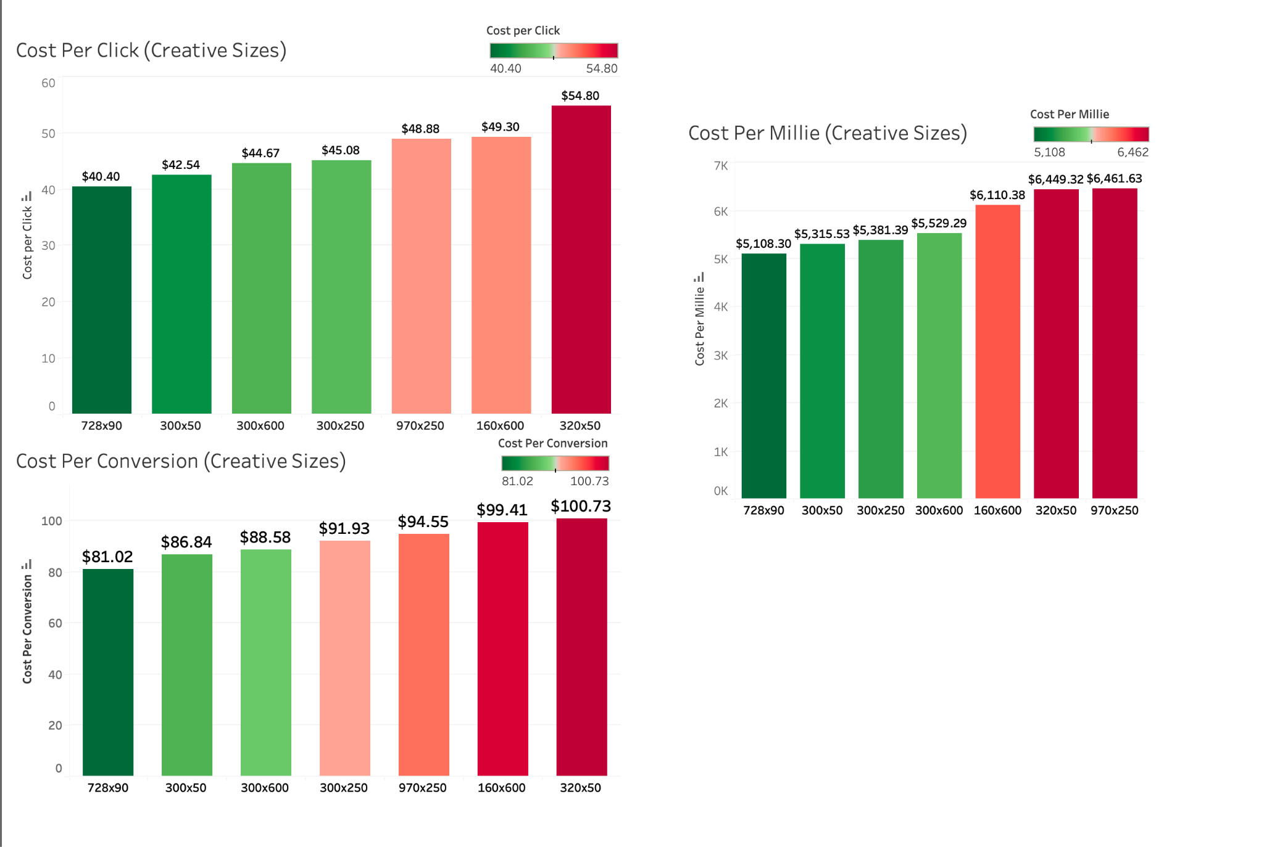
COST EFFICIENCY ANALYSIS
Across all cost metrics, 728x90 proves to be the most cost efficient ad size, followed by 300x50.
Notes:
Billy

Slide 46
TOP CREATIVE SIZES
(BY PERFORMANCE)
VIEWABILITY RATE
728x90 (51.15%)
970x250 (50.12%)
300x50 (49.76%)
160x600 (49.57%)
320x50 (49.46%)
300x250 (48.70%)
300x600 (47.36%)
CLICK-THROUGH RATE
970x250 (13.22%)
728x90 (12.64%)
300x50 (12.49%)
160x600 (12.39%)
300x600 (12.38%)
300x250 (11.94%)
320x250 (11.77%)
CONVERSION RATE
320x50 (54.41%)
970x250 (51.69%)
300x600 (50.42%)
728x90 (49.87%)
160x600 (49.59%)
300x250 (49.04%)
300x50 (48.99%)
Viewability and CTR consistently have the same sizes in its top 3 performers. 970x250 holds top 3 across all three performance metrics despite it being in the bottom half in cost efficiency. 320x50 has a strong conversion rate compared to the others, which could indicate clicks being more intentional.
Notes:
Bily - 970x250 being one of the more cost inefficient sizes is worth acknowledging due it being a strong performer. Most likely due in part to its large size and placement. 970x250 is considered a premium ad slot. (Largest, most viewable etc)
Safe to say that 728x90 is the best overall performer given it is the most cost efficient ad size, and ranks highest in viewability, and places top 2 in CTR. It’s balance of cost efficiency and engagement demonstrates its reliability and strong performance across the board.
320x50 has the strongest conversion rate here despite ranking low amongst the other performance metrics. As a mobile banner, the low viewability and ctr are expected due to them being easily scrolled past. But having the highest conversion rate is a good testament to the ad size attracting more intentional viewers, and high quality traffic.

Slide 47
Ad Formats
Notes:
Kiki

Slide 48
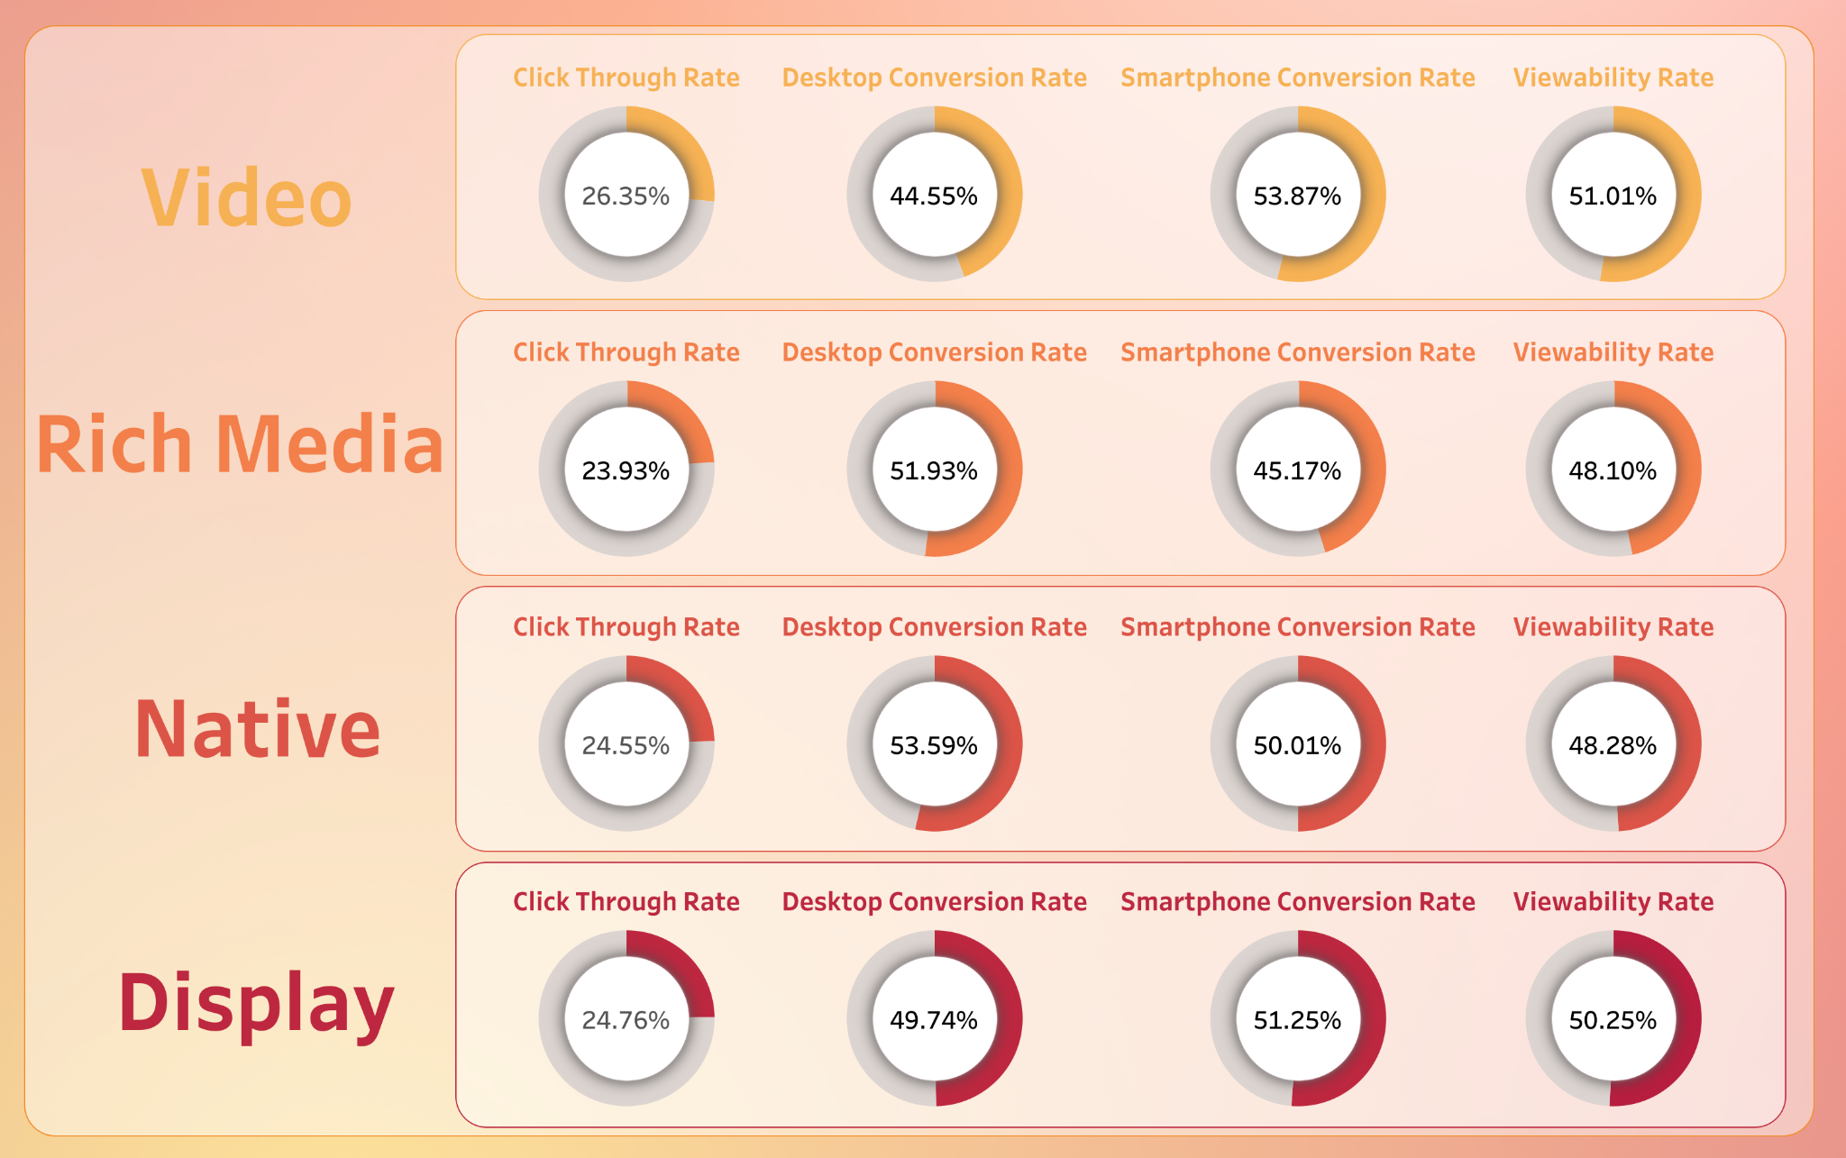
Performance Metrics
All formats exceed the CTR benchmark, showing strong audience interest and high potential reach.
Conversion performance is mixed: desktop often underperforms, while smartphone conversions frequently meet or exceed the 50% benchmark.
Viewability is a major weakness across formats, with all formats significantly below the 70% benchmark.
Notes:
Kiki

Slide 49
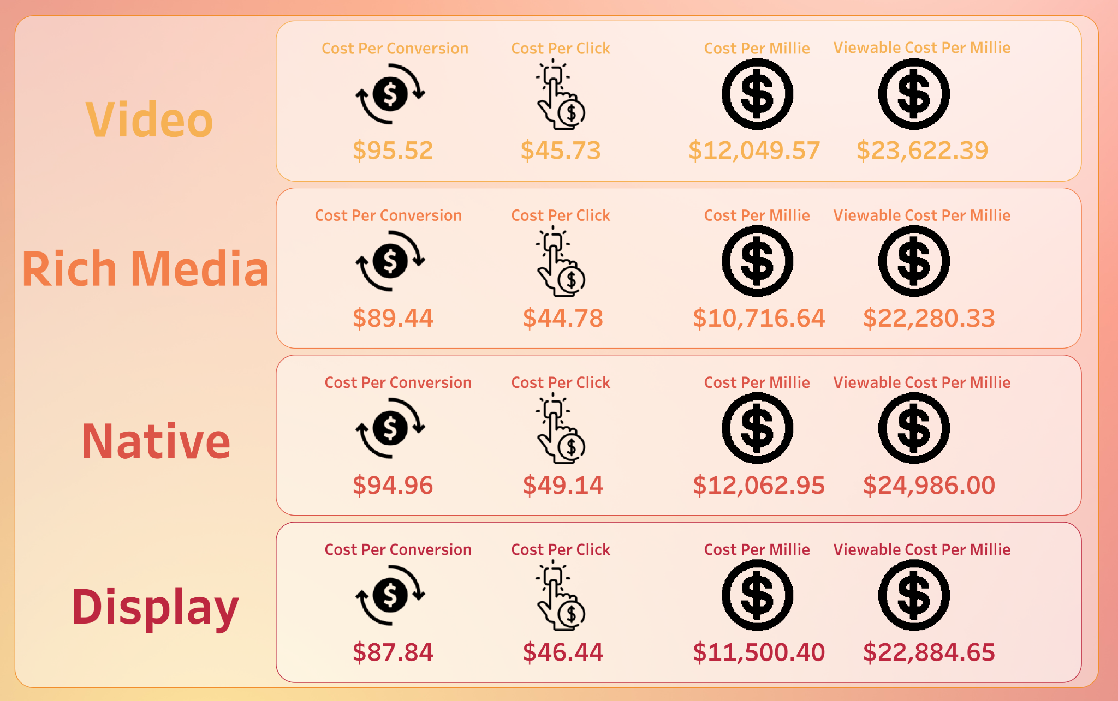
Cost Metrics
Costs are much higher than benchmarks across all formats (CPC, CPM, vCPM).
Cost per conversion is nearly double the goal, signaling inefficiency in the current spend.
High engagement does not translate to cost-effectiveness, suggesting an opportunity to optimize placements or shift budgets.
Notes:
Kiki

Slide 50
Devices
Notes:
Beverly

Slide 51
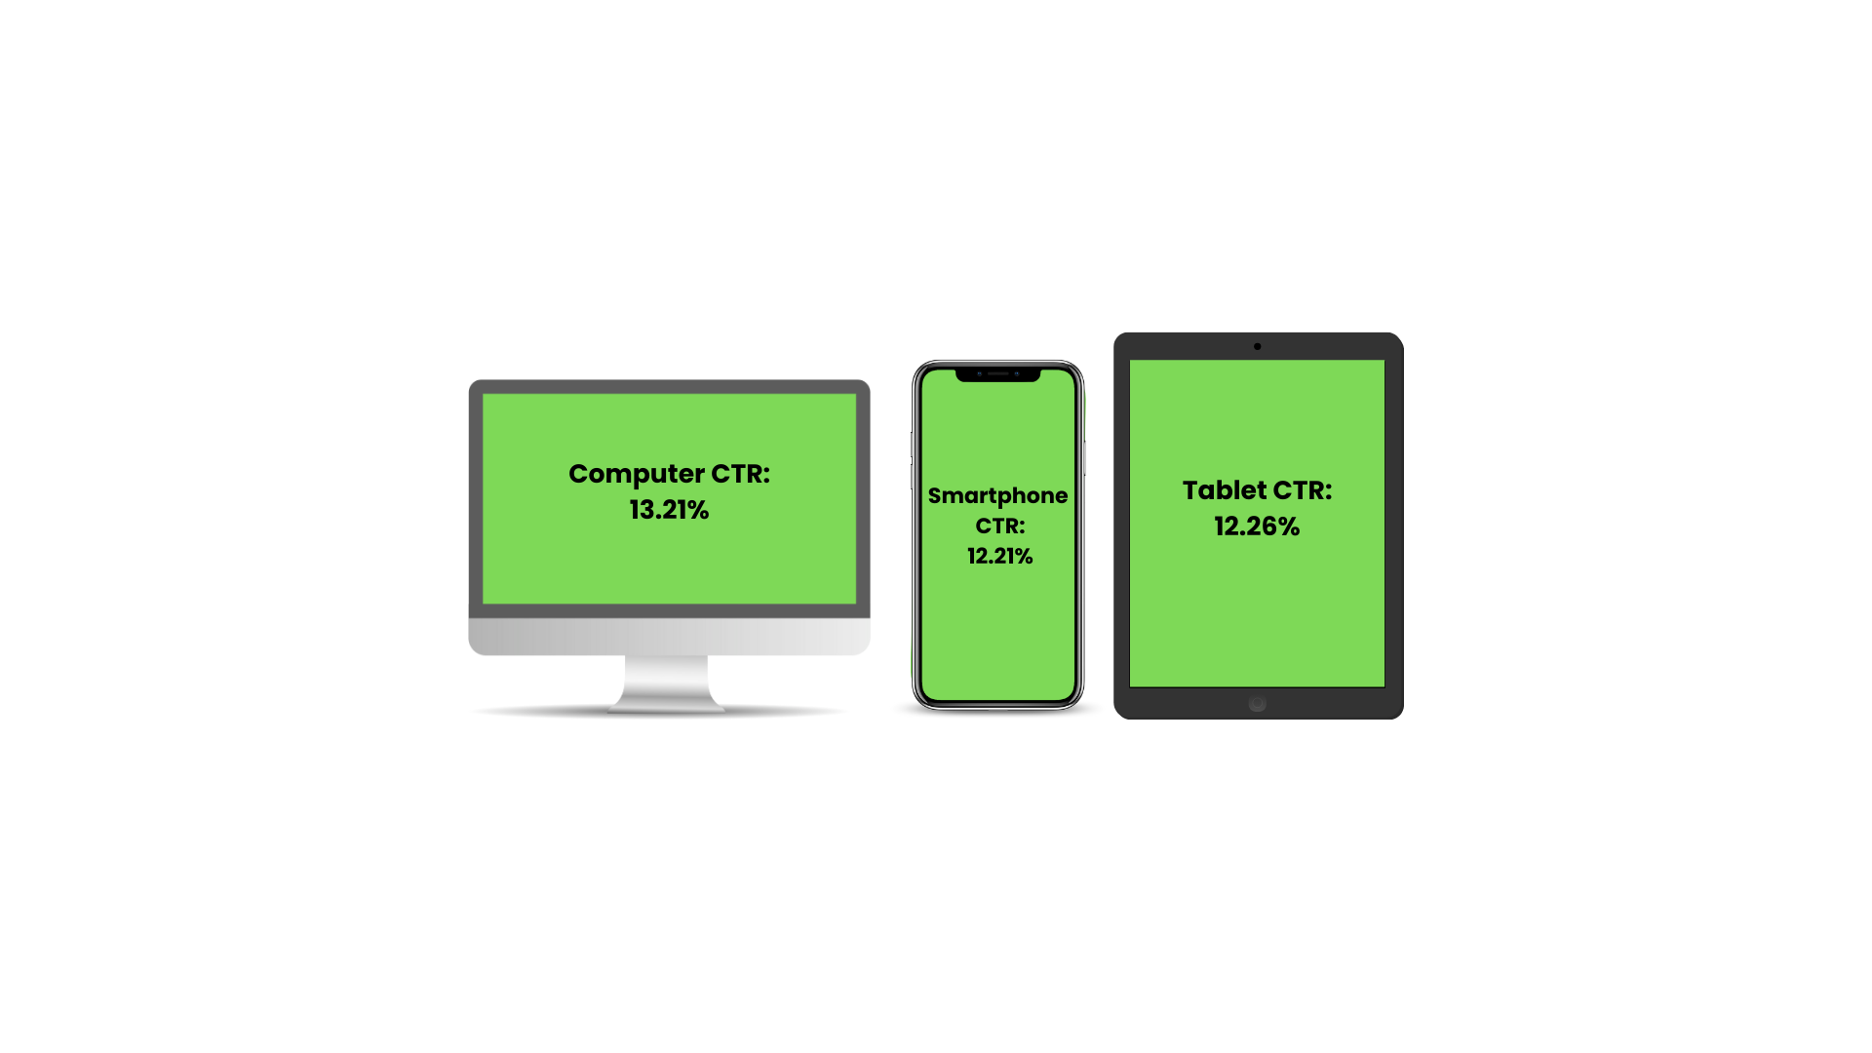
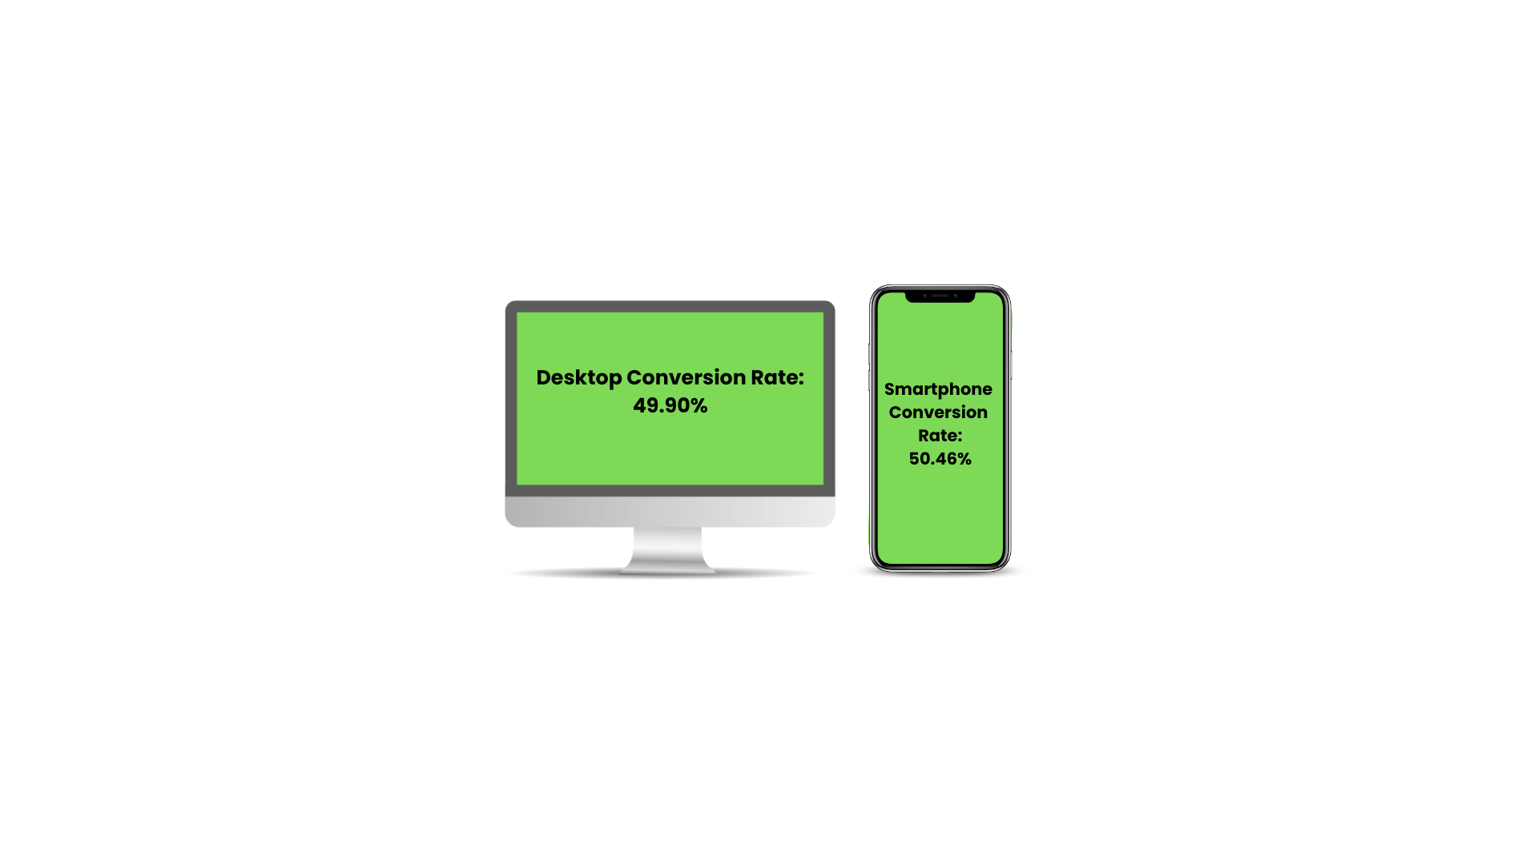
Devices by Performance: CTR & Conversion Rate
Desktop was the top performing device exceeding the 10% CTR benchmark at 13.21% while Smartphone users had the highest conversion rate of 50.46%
All devices; Desktop, Smartphone and Tablet met CTR benchmark goals (over 10%)
Both Desktop and Smartphone exceeded 50% conversion rate benchmark signaling both desktop and smartphone users converted successfully
Notes:
Beverly

Slide 52
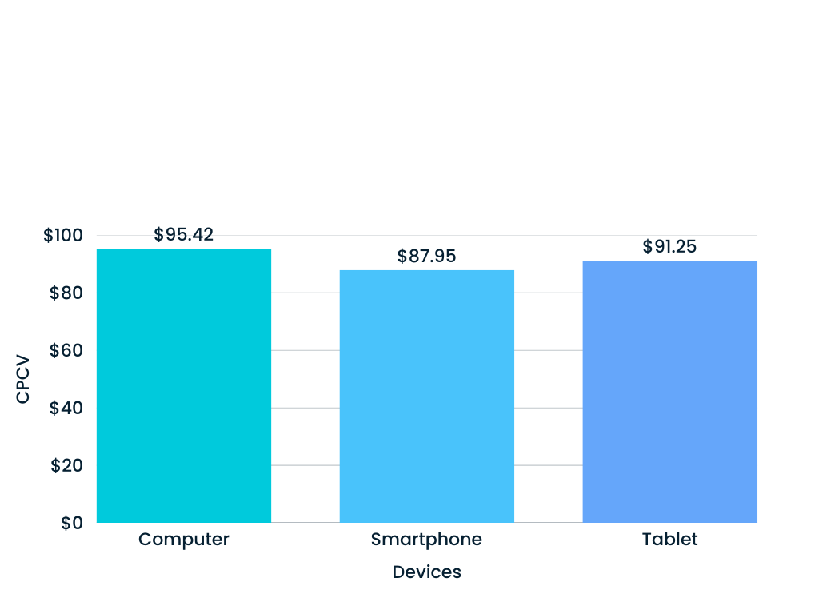
Devices by Performance: CPCV (Cost per Conversion)
Computer, Smartphone & Tablet did not meet primary benchmark goal of $50; Smartphone users had the lowest CPCV but still did not reach the benchmark goal
Notes:
Beverly

Slide 53
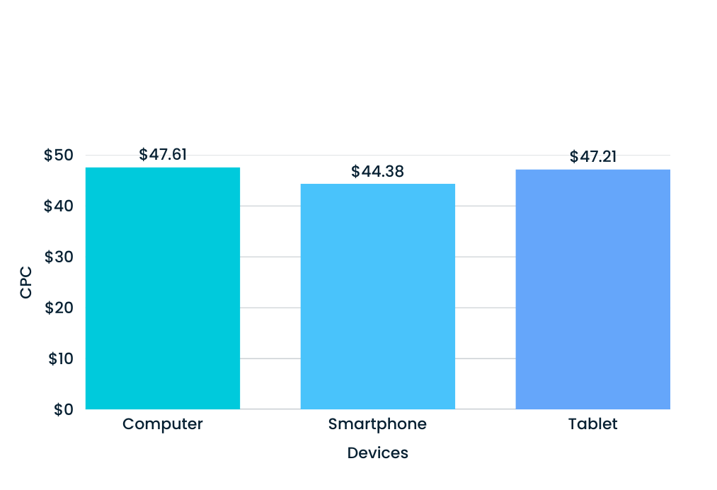
Devices by Performance: CPC (Cost per Click)
Computer, Smartphone, and Tablet did not meet the primary CPC benchmark goals of $25; Smartphone users had the lowest CPC but still did not reach benchmark goals
Notes:
Beverly

Slide 54
Devices: Secondary Goals
Devices
CPM
vCPM
Viewability Rate
Computer
$12,484.57
$24,992.66
49.95%
Smartphone
$10,764.77
$21,560.75
49.93%
Tablet
$11,734.00
$24,054.92
48.78%
None of the devices met the CPM benchmark of $2500 cost per mille or the $5,000 cost per 1,000 viewed impression (vCPM).
Computer or desktop was the closest to the 70% viewability rate benchmark
Notes:
Beverly

Slide 55
Positions
Notes:
Kiki

Slide 56
Ad Position by Performance: CTR
Sidebar CTR:
12.24%
Sidebar CTR:
12.24%
Above the fold CTR: 12.68%
- - - - - - - - - - - - - - - - - - - - - - - - - - - - - - - - - - - - - - - - - - - - - - - - - - - - - - - - - - - - - - - - -
Below the fold CTR: 12.62%
Footer CTR: 12.05%
Notes:
Beverly

Slide 57
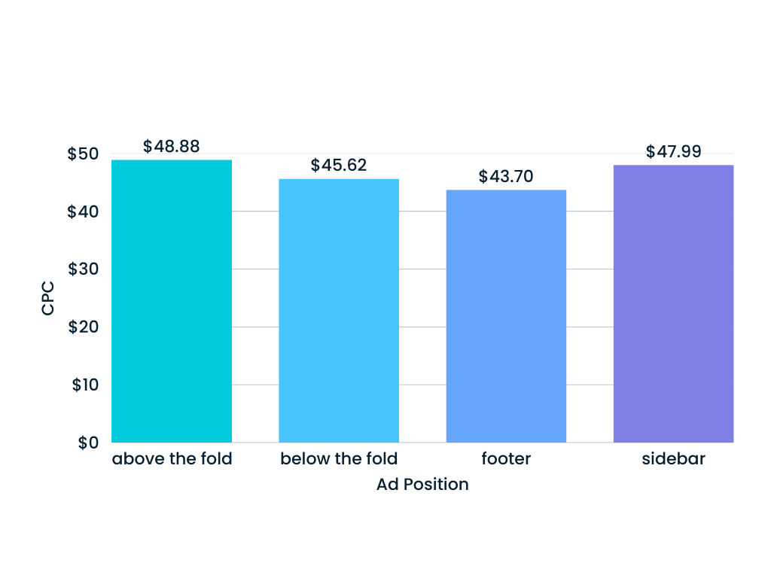
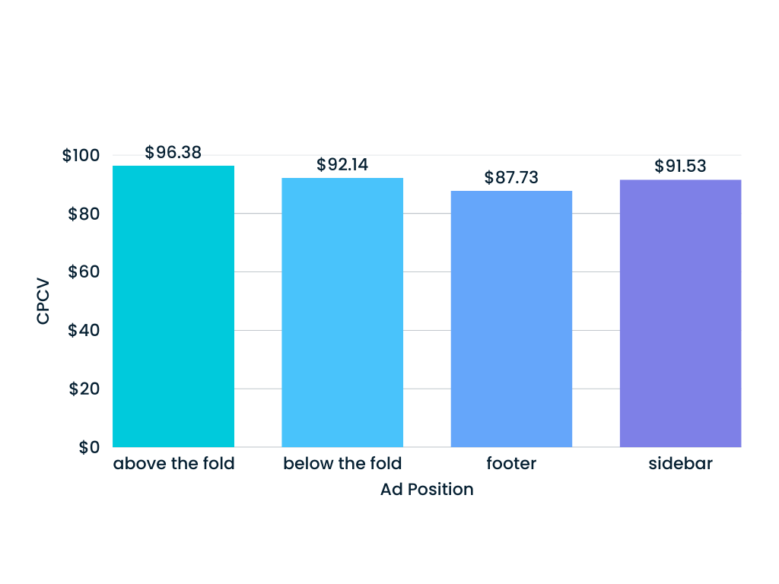
Ad Position by Performance: CPC & CPCV
Notes:
Beverly

Slide 58
Ad Position: Secondary Goals
Ad Position
CPM
vCPM
Viewability Rate
above the fold
$6,197.63
$24,825.57
49.83%
below the fold
$5,755.62
$23,894.68
48.39%
footer
$5,266.94
$21,096.99
50.51%
sidebar
$5,874.77
$24,186.07
48.87%
None of the ad positions met the CPM benchmark of $2500 cost per mille or the $5,000 cost per 1,000 viewed impression (vCPM).
Footer was the closest to the 70% viewability rate benchmark and the closest to the CPM and vCPM benchmark goals.
Notes:
Beverly

Slide 59
Inventory
5
Notes:
Our group is Inventory
In charge of determing
Which inventory sources (virtual platforms) delivered the best performance

Slide 60
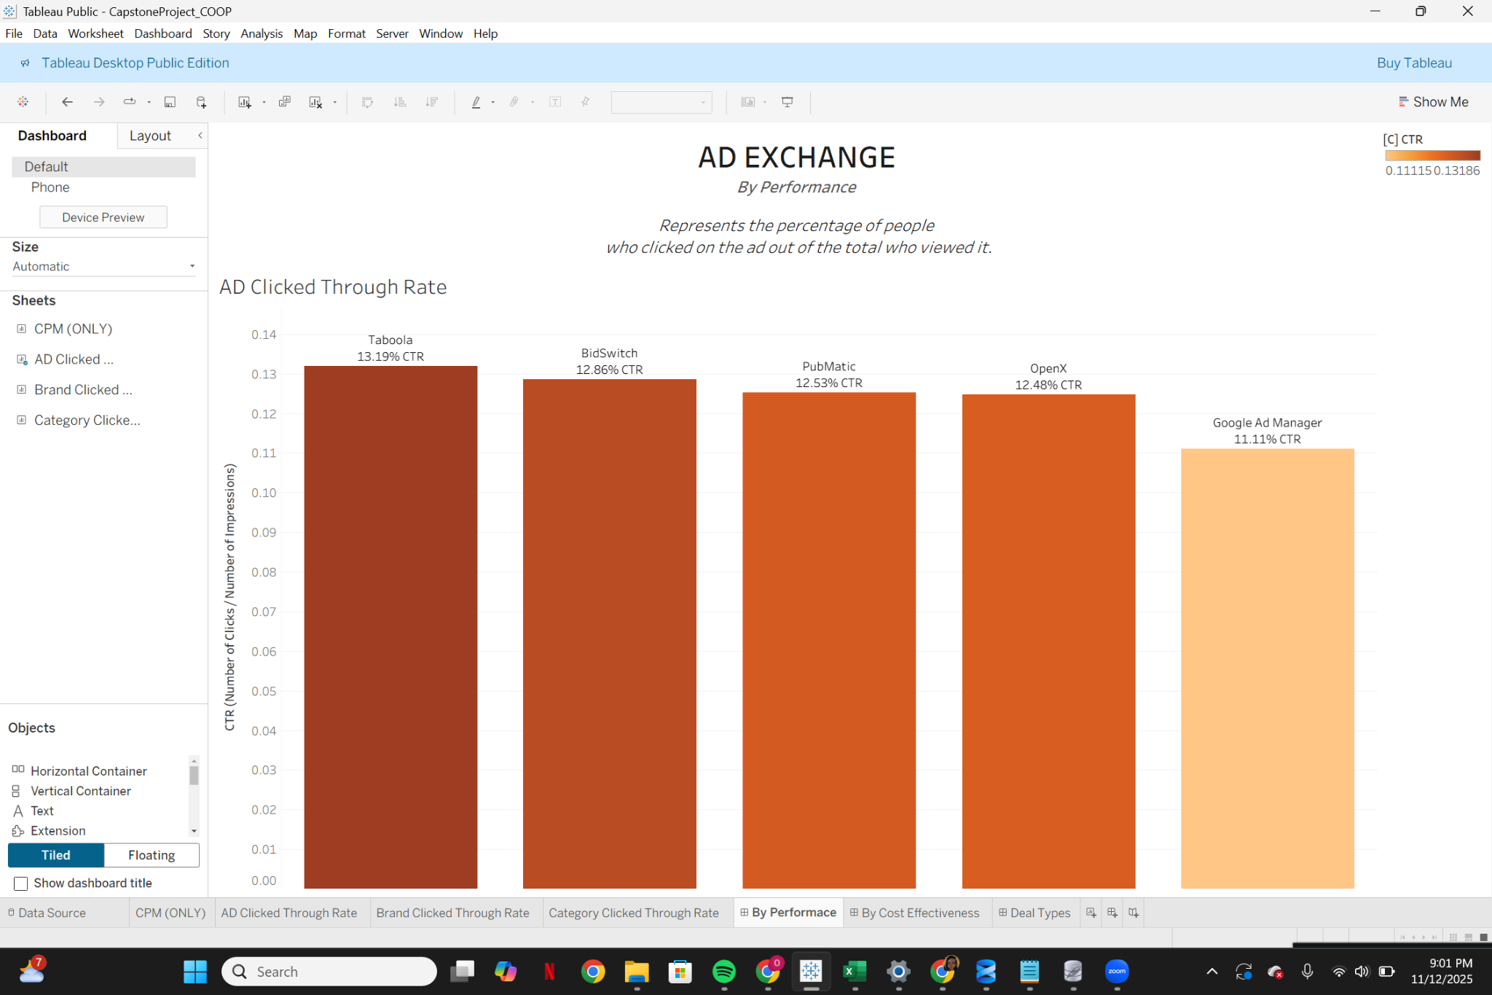
Notes:
The first inventory source we will be talking about is AD Exchange
An ad exchange is basically a digital marketplace where advertisers
determines where your ads get shown, how much it is being shown, and how much you at startuslink have to pay for it
Our team had to decide which AD exchange (dm) is best for your team to use
This chart shows how each ad exchange performed based on CTR
CTR tells us out of all the people who saw our ad how many people clicked on it
The higher the CTR = stronger engagement
As you can see…

Slide 61
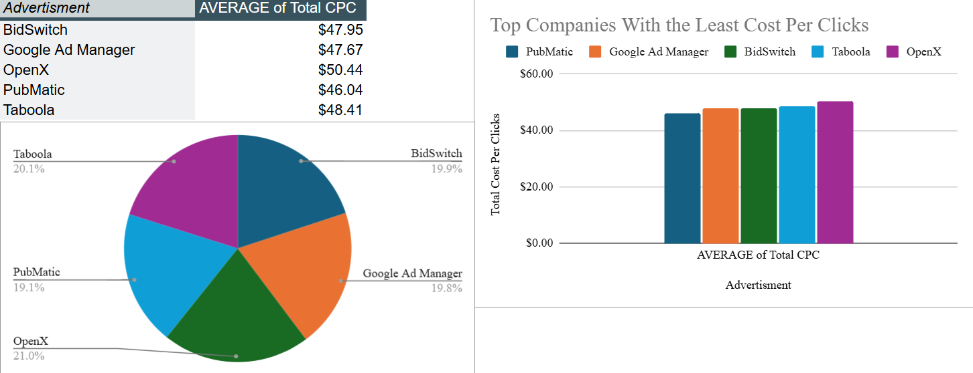

Slide 62
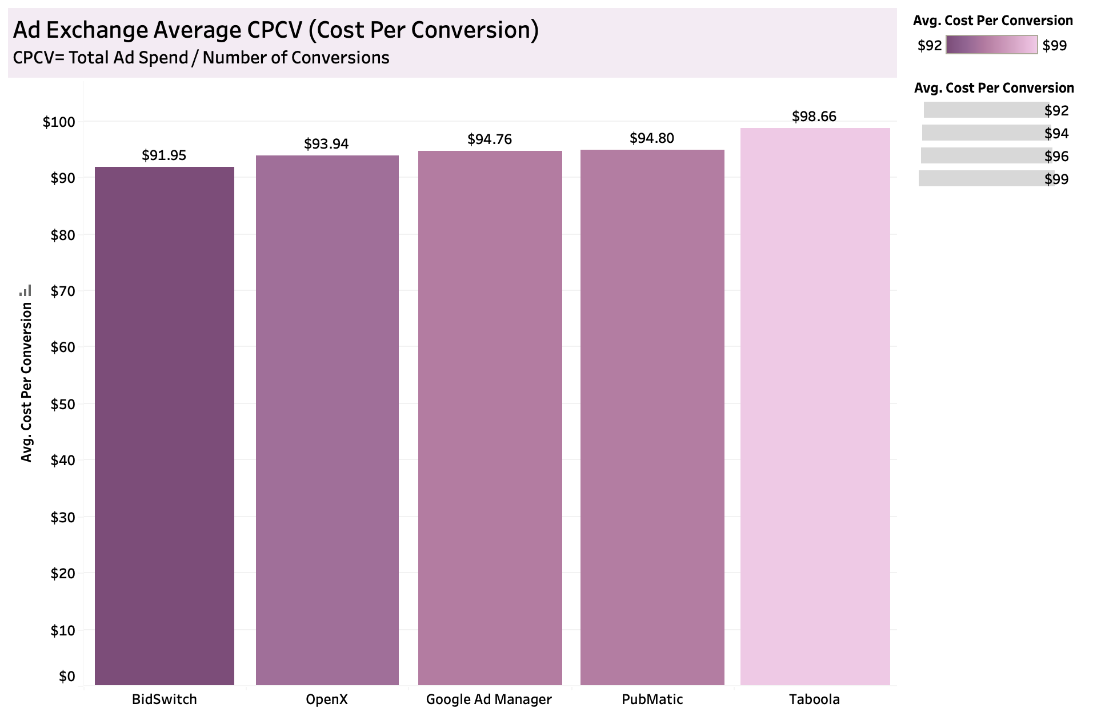
Notes:
Still generating the most clicks while

Slide 63
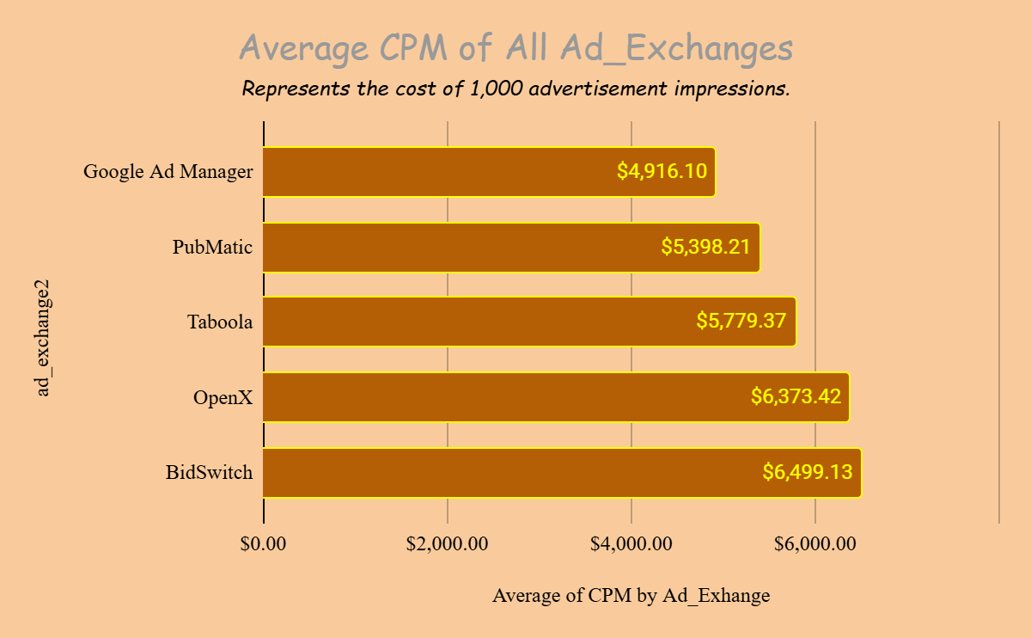

Slide 64


Slide 65

Google Ad Manager
Consistency Ranks Among the Top
Notes:
Still generating the most clicks while

Slide 66

Programmatic
Guaranteed
Highest CTR
Lowest CPC
Lowest Cost per Conversion
Best overall performance
Notes:
The second inventory source we will be talking about is Deal types
Deal types describe how advertisers buy ad inventory from publishers
Open Exchange – open auction, hundreds of buyers competing
Private Marketplace (PMP) - invitation-only auctions, higher quality, but non-guaranteed
Programmatic guaranteed - direct deals with publishers, premium quality, with guaranteed impressions
With all the summarized KPIs
The deal type that performed well consistently is PG

Slide 67

Second Price
Auction
Highest CTR
Lowest CPM
Lowest CPC
Best overall performance

Slide 68

Notes:
The third inventory source we will be talking about is Websites
This slide gives us an overall view of how our campaign performed across different websites and content categories
This is specifically on CTR which tells us how many people actually clicked after seeing our ad
At the top, we highlight the five websites that drove the strongest engagement
These are the environments where users were most responsive to the campaign

Slide 69




Slide 70


Slide 71


Slide 72


Slide 73


Slide 74


Slide 75


Slide 76


Slide 77
TOP 5 WEBSITES
By Performance
 |  | CTR
FASHION | vouge.com | 13.48%
FOOD | food52.com | 13.88%
HEALTH | webmd.com | 14.85%
HOME | architecuteraldigest.com | 12.94%
MUSIC | pitchfork.com | 12.85%
SPORTS | sports.yahoo.com | 14.97%
TECHNOLOGY | cnet.com | 13.38%
TRAVEL | tripadvisor.com | 14.81%
Notes:
This table shows the top-performing websites in each content category based on CTR

Slide 78
TOP 5 WEBSITES
By Cost-Effectiveness
 |  | CPM | CPC | CPCV
FASHION | harperbazar.com | $3,040.83 | $45.58 | $94.87
FOOD | epicurious.com | $4,584.27 | $43.06 | $90.16
HEALTH | healthline.com | $3,699.26 | $46.34 | $88.80
HOME | houzz.com | $3,557.50 | $39.97 | $85.59
MUSIC | billboard.com | $2,554.90 | $50.30 | $94.35
SPORTS | nbcsports.com | $5,867 | $46.81 | $91.25
TECHNOLOGY | techcrunch.com | $2,593.07 | $41.48 | $90.46
TRAVEL | booking.com | $2,723.24 | $42.43 | $86.32

Slide 79
Conclusion
6

Slide 80
Recommendations
Spatial
CTR (Click-Through Rate):
-Increase spend in high-CTR states (Colorado, Iowa, Florida) and peak regions/months (West: Oct/Apr, Northeast: June).
-Reduce spend in low-CTR areas (South Carolina, Nevada, parts of Midwest).
CPC (Cost Per Click):
-Prioritize regions with both high CTR and low CPC ( Maine, Arizona, Indiana) for best campaign value.
-Reduce spend in high CPC + low CTR areas.
CPM & Viewable CPM:
-Invest in urban markets with lower CPM and strong conversion rates.
-Streamline rural targeting for CPM efficiency.
Device & Region:
-Prioritize mobile and web devices in regions where CPM is low and CTR is high.
-Leverage smartphone strengths in the Northeast and investigate why performance is better than other devices.
Conversion Rate:
-Conversions are meeting or near targets across regions/devices; focus on sustaining strengths.
2. Audience
Increase amount of ads during the late afternoon to early evenings and late nights (best view times).
Reallocate funds towards the Health, Home, Fashion, and Food interest segments, which form high-value interest pools because they deliver strong CTR, lower CPC, and mid-range CPM, making them ideal segments to pitch to clients.
Prioritize campaigns such as health and home for retired, married/widowed audiences in their 40’s to 60’s from low income households with children (low CPC).
Reallocate campaigns targeted towards male high school graduates unemployed or laborers from single-person households in their 30’s (high cost) to other low cost campaigns and high engagement audiences.
Notes:
Spatial - Audience - Creative - Beverly or Billy?
Inventory -

Slide 81
Recommendations
3. Creative
Creative Messaging - Need to improve CPCV by highlighting clear value. Could also apply this for the desktop messaging that are underperforming.
Need to improve CPC by using keywords and refining audience.
Focus on smartphone conversion rates with clear CTAs.
There are high CPM costs across all the messaging, but if the primary goals are being met, then the high cost is justified.
Creative Sizes - Prioritize 728x90 as Primary Ad Size. Performs best across all sizes.
Reduce investment in 160x600. Very costly and doesn't compensate with strong performance.
Evaluate spending on 970x250. Engagement is great but given its cost, it’s important to be intentional on when to use this placement. Preferably high value campaigns or when brand impact is a priority. For when impact > efficiency.
Ad Formats: Optimize ad placements to ensure they appear in high viewability positions, especially on mobile where performance was stronger.
Refine bidding strategies, such as lowering bid caps or shifting away from CPM to CPC bidding, to avoid overpaying for low-quality inventory.
Reallocate spend away from expensive, low-performing placements towards high viewability inventory.
Devices - Prioritize Smartphone users because they had the highest conversion rates. While Desktop users had the highest CTR, smartphone users converted 0.56% more.
Recommend improving CPC by optimizing ad copy for a higher click-through rate, enhancing landing page content, and implementing retargeting campaigns to help reduce costs.
Recommend improving CPCV by by excluding irrelevant searches which will enhance ad relevance, which can boost your Quality Score and further reduce CPCV
Notes:
Spatial - Audience - Creative - Beverly or Billy?
Inventory -

Slide 82
Recommendations
4. Inventory
Google Ad Manager = most cost-effective ad exchange. Although they have the lowest CTR, they still generate impressions and conversions at the lowest cost
Programmatic Guaranteed = most cost-effective and highest performance. Shows the highest CTR and lowest CPC, CPCV. However, CPM was not the most cost-efficient. CPMs can be improved by improving website performances and developing different advertising strategies. This can be done by making sure the website can move quickly and are computer and mobile accessible, test out different locations and formatting of the advertisements and create content to be relevant to users.
Second Price Auction wins in cost-effectiveness and performance. Indicated the highest CTR, lowest CPM and CPC. Although the CPCV was not the most cost efficient, second price still yielded overall best performance. The CPCV difference was very minimal.
sports.yahoo.com for performance (CTR); houzz.com for CPC and CPCV; billboard.com for CPM
Best return on ad spend, budget should be reallocated to these ad exchanges, deal types, auction types, and websites
Notes:
Spatial - Audience - Creative - Beverly or Billy?
Inventory -

Slide 83
StratusLink Communications - Performance One Pager
Executive Summary: Fellows from Cohort C577 in the COOP Careers Fellowship presented an analysis to StratusLink Communications on their marketing campaign using Spatial, Audience, Creative, and Inventory data.
Business Problem: It’s important to solve the issue of high advertising costs because StratusLink wants to improve the cost per ad conversion while maintaining high engagement. For reference, the primary KPI benchmark goals are CPCV with a target amount of $50 and CPC with a target amount of $25. The percentage goals were 10% for CTR and 50% for Desktop and Smartphone Conversion Rate. Key Highlights:
Major KPIs:
- Cost Per Conversion (CPCV): ($50) Track spend per valuable action. Smartphones had the lowest CPCV of $87.95 out of all the devices.
- Click Through Rate (CTR): (10%) Reflects ad relevance and user engagement. Highest CTR States: 27-28%
- Cost Per Click (CPC): ($25) Measures cost-efficiency per user click. Google Ad Manager had a average total CPC of $47.67.
- Cost Per Mille (CPM): ($2,500) General Cost per 1,000 impressions. Music had a CPM of $2,554.90.
Recommendations and Next Steps: - Prioritize urban markets with lower CPMs and strong conversion rates; increase ad volume during late afternoons, evenings, and late nights when viewership peaks.
- Shift more budget into Health, Home, Fashion, and Food segments, which consistently deliver strong CTR, lower CPC, and mid-range CPM.
- Optimize for mobile by emphasizing smartphone conversions and using clear, action-driven CTAs.
- Reduce spending on 160×600 placements, which are costly and underperforming.
- Continue leveraging Google Ad Manager as the most cost-effective exchange; despite lower CTRs, it still produces high-value impressions and conversions at the lowest cost.
Future Plans:
Phase 1: (Immediate): Shift budget toward efficient states/devices, update creative messaging, emphasize smartphone users.
Phase 2: (30 days): Restructure exchange + ad format purchasing to focus on Programmatic Guaranteed & Second Price.

